Slide 1
The Paradox of Highly Effective
Sofosbuvir Combo Therapy
Despite Slow Hepatitis C Viral Decline
THT Nguyen (1), J Guedj (1), L Canini (2,3), A Osinusi (4), PS Pang (4),
J McHutchison (4), H Masur (5), A Kohli (6), S Kottilil (7) & AS Perelson (2)
  IAME, UMR 1137 INSERM – University Paris Diderot
  Theoretical Biology and Biophysics Group, Los Alamos National Laboratory
  Epidemiology Research Group, University of Edinburgh
  Gilead Sciences
  Critical Care Medicine Department, NIH Clinical Center
  Clinical Research Directorate/Clinical Monitoring Research, Program Leidos Biomedical Research, Inc
  Laboratory of Immunoregulation, NIAID, NIH
PAGE 2016, Lisboa, Portugal

Slide 2
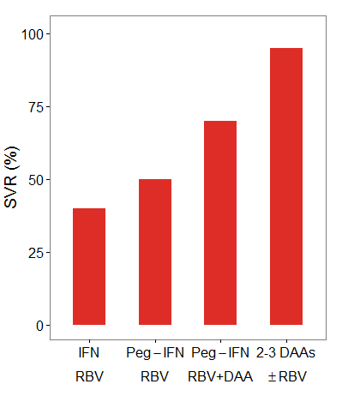
Hepatitis C virus infection & Treatment
Introduction
Chronic infection with hepatitis C virus (HCV) is a major cause of advanced liver diseases⁽¹⁾
The goal of antiviral treatment is to achieve a sustained virologic response (SVR), i.e., HCV eradication^{(2,3)}
1998
2001
2011
2014-2016
Since 2011, revolution in HCV therapy with the introduction of Direct Acting Antivirals (DAA) ^{(4,5)}:
  Significantly increased response rate
  Significantly reduced treatment duration
Treatment
(1) MOHD et al, Hepatol, 2013
(2) CARRION et al, Exp Opin Pharmacother, 2014
(3) LAWITZ et al, J Hepatol, 2013
(4) PAWLOTSKY, Gastroenterol, 2014
(5) KOHLI et al, JAMA, 2014
Duration (weeks)
24-48
24-48
24-48
6-12

Slide 3
Sofosbuvir-based treatments
Introduction
Sofosbuvir (SOF) is a potent nucleotide analog with high genetic barrier to resistance
SOF is largely used as a backbone in combination with NS5A inhibitor (Ledipasvir – LDV, Daclatasvir) or protease inhibitor (Simeprevir)
Treatment |  |  |  | Duration (weeks)
NS5B nuc Inhibitor | NS5A Inhibitor | NS5B non-nuc Inhibitor | NS3 Inhibitor | 24 | 12 | 8 | 6
SOF |  |  |  | ~80%^{*(1,2)} | ~70%^{*(3,4)}
SOF | LDV |  |  | 99%⁽⁵⁾ | 95%⁽⁶⁾ | 93%⁽⁶⁾ | 68%^{*(7)}
SOF | LDV | GS-9669 |  |  |  |  | 95%⁽⁸⁾
SOF | LDV |  | GS-9451 |  |  |  | 95%⁽⁸⁾
+
+
+
+
+
*In combination with RBV
(1) SULKOWSKI et al, JAMA 2014
(2) MOLINA et al, Lancet, 2015
(3) GANE et al, N Engl J Med, 2013
(4) LALEZARI et al, EASL 48th Annual Meeting, 2013
(5) AFDHAL et al, N Engl J Med, 2014
(6) KOWDLEY et al, N Engl J Med, 2014
(7) GANE et al, Gastroenterol, 2014
(8) KOHLI et al, Lancet, 2015

Slide 4
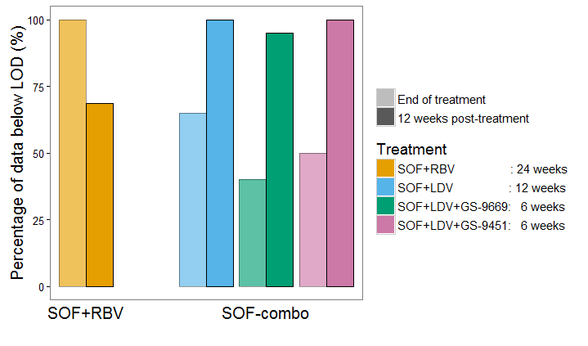
Paradox of short SOF-combo treatments
Introduction
  Large proportions of patients with detectable viral load at the end of treatment (EOT) despite high SVR rates⁽¹⁾
  Phenomenon also observed with similar short treatments⁽¹⁻²⁾
New feature not observed in long treatments
(1) KOHLI et al, Lancet, 2015
(2) HEZODE et al, EASL 2015, Abstract P0843
(3) SARRAZIN et al, J Virol Methods, 2015

Slide 5
Objectives
Introduction
How to explain the paradox between high proportion of detectable viral load at the end of treatment and high SVR after short treatment?
Can we predict the outcome for even shorter treatment durations such as 6 weeks of dual therapy or 4 weeks of triple therapy ?

Slide 6
Studies & Data
Studies & Data
Data obtained from two studies: SPARE¹ and SYNERGY²
Patients:
  Mostly American African (80-90%)
  Infected with GT-1a or GT-1b virus (30% GT-1b)
Viral load data: Abbott real-time PCR assay with limit of quantification (LOQ) of 12 and limit of detection (LOD) of 3 IU/mL
Study | Treatment |  |  |  | Design
 | NS5B nuc Inhibitor | NS5A Inhibitor | NS5B non-nuc Inhibitor | NS3 Inhibitor | Duration | Number of patients
SPARE⁽¹⁾ | SOF* |  |  |  | 24 | 50
SYNERGY⁽²⁾ | SOF | LDV |  |  | 12 | 20
 | SOF | LDV | GS-9669 |  | 6 | 20
 | SOF | LDV |  | GS-9451 | 6 | 20
+
+
+
+
+
*In combination with RBV
(1) OSINUSI et al, JAMA, 2013
(2) KOHLI et al, Lancet, 2015

Slide 7
Multiscale model for direct acting agents⁽¹⁾
Methods
Infection
Infected cell
Assembly/
secretion
Replication
Uninfected
cell
Virions
NS3/NS5A
inhibitors
c
NS3/NS5A/NS5B
inhibitors
d
δ
All drugs block viral RNA replication
NS5A and NS3 inhibitors also block viral assembly/secretion^{(1,2)}
The antiviral effect of RBV is negligible
(1) GUEDJ et al, PNAS, 2013
(2) RONG et al, Plos Comput Biol, 2013

Slide 8
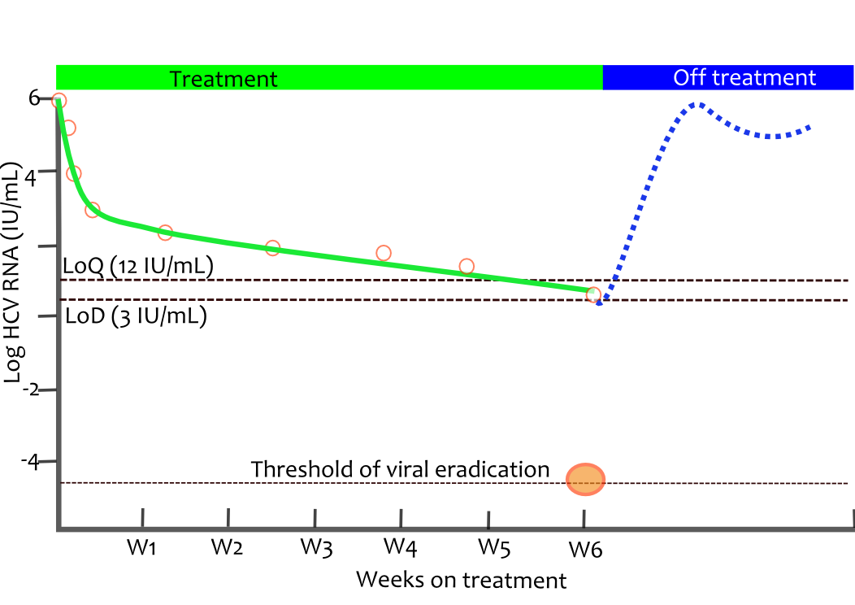
Multiscale model cannot explain continous viral decline after treatment
Methods
~ 1 million of virions produced every day !
  A long way to go from HCV RNA at the level of detection until clearing the last virion particle in the whole body fluid⁽¹⁾
(1) DIXIT et al, Nature, 2004

Slide 9
What can explain the paradox?
Hypothesis
Prolonged intracellular pharmacokinetics:
  SOF active metabolites have long half-life ~24 hour⁻¹⁽¹⁾
  But activity would need to be maintained for more than 18 weeks to solely explain SVR
Immune system:
  Restoration of immune response during IFN-free treatment⁽²⁾
  No immunological data, high inter-individual variability in immune response
Non-infectious virus:
  Consistent with the fact that NS5A/NS3 proteins may be involved in the production of infectious virus⁽³⁻⁶⁾
(1) ROWER et al, CROI Annual Meeting, Abstr 81, 2015
(2) SERTI et al, Hepatol, 2016
(3) TELLINGHUISEN et al, Plos Pathog, 2008
(4) OGAWA et al, Proc Jpn Acad Ser B Phys Biol Sci, 2009
(5) SHIMAKAMI et al, Gastroenterol, 2011
(6) MIYANARI et al, Nat Cell Biol, 2007

Slide 10
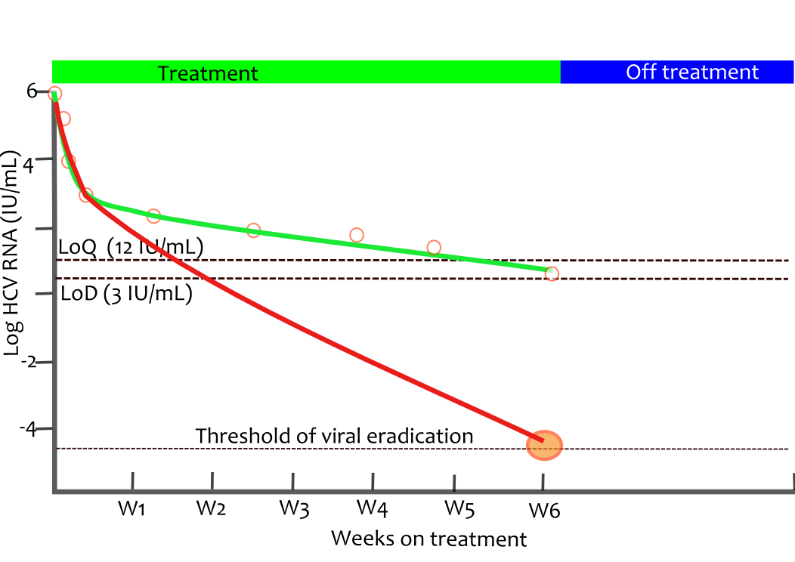
Extension of multiscale model to take into account infectious virus
Methods
Total virus
Infectious virus
  Most of virus observed at EOT are non-infectious virus

Slide 11
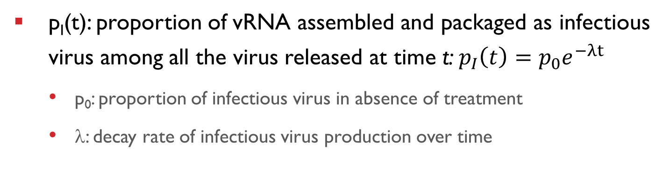
Extended multiscale model
Methods
β
Infection
Infected cell
Assembly/
secretion
β
ρ(1-ε_{s})p_{I}(t)
Uninfected
cell
Infectious
virions
Replication
c
NS3/NS5A
inhibitors
α(1-ε_{α})
ρ(1-ε_{s})(1-p_{I}(t))
NS3/NS5A/NS5B
inhibitors
d
Non infectious
virions
c
δ
p_{I}(t): proportion of vRNA assembled and packaged as infectious virus among all the virus released at time t:$p_{I}\left(t\right)=p_{0}e^{−λt}$
  p₀: proportion of infectious virus in absence of treatment
  λ: decay rate of infectious virus production over time

Slide 12
Estimation of viral kinetic parameters from total virus
Methods
Solution for total virus (infectious + noninfectious):
  contains all viral kinetic parameters, except for parameters related to infectious virus (p₀ and λ)
  These viral kinetic parameters can be estimated from the observed total viral load
Parameter estimation:
  Estimated by fitting the solution for total virus to observed data until EOT
  Effect of treatment on different viral kinetic parameters was tested using likelihood ratio test
  Estimation method: SAEM in MONOLIX 4.3.2 to handle data below LOQ and LOD
$$V_{total}(t)=V_{0}\left(e^{−ct}\left(1−ε_{s}\right)\frac{cρ}{N}\left(\left.\frac{A}{Bδ\left(δ−c\right)}\left(e^{−ct}−e^{−δt}\right)+\frac{1}{B+δ−c}\left(\frac{N}{ρ}−\frac{A}{Bδ}\right)(e^{−ct}−e^{−\left(B+δ\right)t}\right)\right)\right)$$

Slide 13
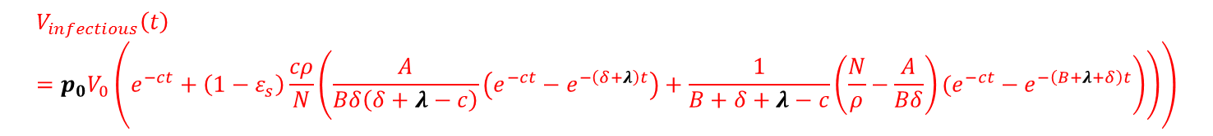
How to obtain parameters related to infectious virus?
Methods
New parameters p₀ and λ only depend on infectious virus
No observation for infectious virus
Fix p₀ at different values from 0.1% to 100% (only results with p₀=100% are presented)
Determine the decay rate of infectious virus proportion λ by calibration:
  Simulate 1,000 patients with the viral kinetic parameters obtained from the total viral load for each treatment group
  Find the minimal decay rate λ for each treatment so that infectious virus is cleared in 95% of patients at EOT (8 weeks for SOF+LDV and 6 weeks for SOF+LDV+DAA)
$$V_{infectious}\left(t\right)=p_{0}V_{0}\left(e^{−ct}+\left(1−ε_{s}\right)\frac{cρ}{N}\left(\left.\frac{A}{Bδ\left(δ+λ−c\right)}\left(e^{−ct}−e^{−\left(δ+λ\right)t}\right)+\frac{1}{B+δ+λ−c}\left(\frac{N}{ρ}−\frac{A}{Bδ}\right)(e^{−ct}−e^{−\left(B+λ+δ\right)t}\right)\right)\right)$$

Slide 14
Viral kinetic parameters from total viral load
Results
ε in blocking assembly/secretion |  | ε in blocking replication |  | δ (day⁻¹)
0 (-) | 0.997 (RSE=3%) | 0.9996 (RSE=2%) | 0.98 (RSE=5%) | 0.20 (RSE=9%) | 0.14 (RSE=7%)
 |  | P<10⁻¹⁰ |  | P=0.0025
SOF+RBV | SOF+LDV SOF+LDV+GS-9669 SOF+LDV+GS-9451 | SOF+RBV | SOF+LDV SOF+LDV+GS-9669 SOF+LDV+GS-9451 | SOF+RBV SOF+LDV+GS-9451 | SOF+LDV SOF+LDV+GS-9669
  Patients receiving combinations had:
  a lower effect in blocking vRNA replication
  a slower final phase of viral decline
  Modest final phase in all patients compared to NS3 inhibitors-based therapy^{(1,2)}
(1) RONG et al, Plos Comput Biol, 2013
(2) GUEDJ et al, Antivir Ther, 2014

Slide 15
SVR rate predicted from total virus (assuming all observed virus are infectious)
Results
Treatment | Duration (weeks) | Predicted SVR (%) [95% PI] | Observed SVR (%)
SOF+RBV | 24 | 90% [78-96] | 68%
SOF+LDV | 12 | 34% [20-46] | 93%
SOF+LDV+GS-9669 | 6 | 6% [0-14] | 95%
SOF+LDV+GS-9451 | 6 | 16% [6-26] | 95%
SVR for SOF+RBV is overestimated but is comparable with other 24-week trials with SOF (~85%)^{(1,2)}
SVR for SOF-combo therapy is largely underestimated
Assuming all virus are infectious cannot reproduce SVR of SOF-combo therapy ⇒ Combo-therapy yields non-infectious virus
(1) GANE et al, N Engl J Med, 2013
(2) MOLINA et al, Lancet, 2015

Slide 16
Prediction of infectious virus proportion over time for combo-therapy
Results
Treatment | Duration (weeks) | λ (day⁻¹) | Predicted proportion of infectious virus (%)
 |  |  | W0 | W1 | W4 | W6
SOF+LDV | 8 | 0.25 | 100 | 18.11 | 0.097 | 0.0030
SOF+LDV+GS-9669 | 6 | 0.36 | 100 | 8.63 | 0.0048 | 0.000032
SOF+LDV+GS-9451 | 6 | 0.33 | 100 | 10.61 | 0.011 | 0.00011

Slide 17
SVR for shorter treatment
Results
  With the estimated decay rate for each combination
    ^{(*)} Similar combination: SOF+MK-8742 (NS5A inhibitor)+MK-5172 (NS3/4A inhibitor)
Treatment | Duration (weeks) | Predicted SVR [95% PI] | Observed SVR
SOF+LDV | 6 | 60% [48-74] | 68%⁽¹⁾
SOF+LDV | 4 | 14% [4-22] | (-)
SOF+LDV+GS-9669 | 4 | 34% [22-50] | (-)
SOF+LDV+GS-9451 | 4 | 44% [30-60] | 40%⁽²⁾ – 38.7%^{*(3)}
  (1) GANE et al, N Engl J Med, 2013
  (2) KOHLI et al, Ann Intern Med, 2015
  (3) LAWITZ et al, AASLD 2014

Slide 18
Conclusion
Conclusion
Paradox of SOF-combo therapy
  High response rate after short treatment duration
  In spite of slow viral kinetics & detectable viremia in ~ half of patients at EOT
Viral kinetics, in particular at EOT, may not be a reliable marker of treatment outcome (SVR)
Suggests a “hidden” effect not reflected in the HCV viral load

Slide 19
Conclusion
Conclusion
Paradox explained by the effect of NS5A & NS3 inhibitors in generating non-infectious virus
  Allow to reproduce SVR obtained with shorter treatments, regardless of the baseline proportion of infectious virus
  Validation in vitro comparing intracellular, extracellular and infectious virus for these drug regimens is on going (Susan L. Uprichard, University of Illinois at Chicago)

Slide 20
Thank you for your attention!

