Slide 1
A Pharmacometric Approach to Optimise Fixed-Dose Combinations of Rifampicin, Isoniazid, and Pyrazinamide for Children with Tuberculosis
PAGE meeting 2021
Tuesday, 7 September 2021
Roeland Wasmann
Postdoctoral Research Fellow
Pharmacometrics group
Department of Clinical Pharmacology
University of Cape Town

Slide 2
Tuberculosis
10 million people fell ill
1,2 million children among them
Tuberculosis (TB) is curable
Treatment
3-4 drug regimen for 2 months
2 drug regimen for 4 months
Notes:
In 2019, an estimated 10 million people fell ill with Tuberculosis, 1,2 million children among them.
The good thing is that Tuberculosis is curable with a 6 months regimen
2 months with 3-4 drugs (Rifampicin, isoniazid, pyrazinamide and ethambutol
4 months with 2 drugs (Rifampicin, isoniazid)

Slide 3
Tuberculosis treatment
Notes:
This can be a huge pill burden, especially if these patients are also living with HIV, therefore an FDC is important
As a neglected population there is little economic interest to develop a fixed dose combination to lower the burden.
It took a long while for the current fixed dose combination was made but It might not be optimal.
One of the goals here was to put some more sciences into making these FDCs

Slide 4
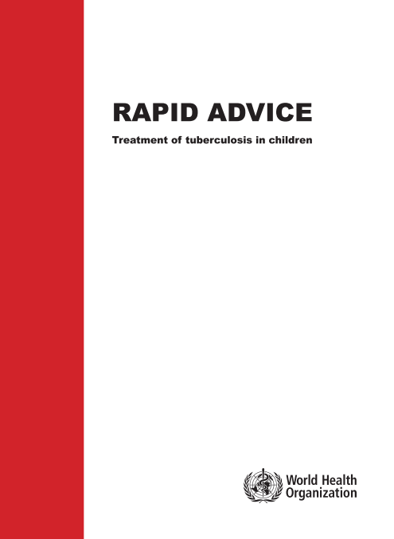
Setting
Revised doses for first-line anti-tuberculosis drugs in children – WHO 2010 Rapid Advice¹
Dose recommendations¹
Rifampicin 15 (10-20) mg/kg
Isoniazid 10 (7-15) mg/kg
Pyrazinamide 35 (30-40) mg/kg
To facilitate uptake, a fixed-dose combination (FDC) was recommended^{2,3}
Rifampicin 75 mg
Isoniazid 50 mg
Pyrazinamide 150 mg
Notes:
Initially same mg/kg range and then increased in 2010

Slide 5
Aim
1. Investigate exposure of rifampicin, isoniazid and pyrazinamide (R/H/Z) under 2010 WHO dosing guidelines. 2. Assess dose regimens focusing on optimization of rifampicin using current FDCs 3. Design a new optimized FDC and improve weight bands that achieve target exposures for all three drugs

Slide 6
Methods
Children on first-line TB treatment in Malawi and South Africa
Inclusion 0 to 12 years-of-age
Dosing according 2010 WHO mg/kg recommendations¹
Intensive PK sampling after one month of treatment
Data analysis using population pharmacokinetic modeling
Notes:
Mention that we used single formulations on the day of PK.
FDC was not available at the time.
Malawi:
- Queen Elizabeth Central hospital, Blantyre
South Africa:
Desmond Tutu TB Centre
Red Cross Children's Hospital
Tygerberg Hospital

Slide 7
Baseline characteristics
180 children
2.5 mo - 12 years
3.2-29 kg
42% female
14% HIV +
~840 samples
25% Slow
57% Intermediate
142 NAT2
18% Fast
21% Missing
Notes:
N-acetyltransferase 2 genotype
38 NAT2 missing

Slide 8
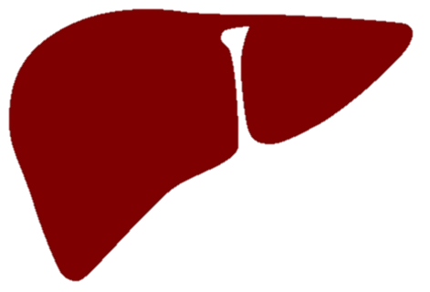
Rifampicin model
Dose
Pre-hepatic bioavailability
Transit compartments
Q_{H}(1-E_{H})/V_{H}
Central Cmpt
Absorp
Cmpt
Ka
Liver
Cmpt
Liver
Cmpt
Q_{H}/V
Absorp Transit Time (MTT) +
Number of Trans Cmpts (NN)
Saturable Extraction
Q_{H}E_{H_excr_SAT}/V_{H} = CL_{H_excr_sat}/V_{H}
Covariates
- Allometric scaling with FFM
- Maturation of clearance
- Age on bioavailability
- Formulation on bioavailability
Notes:
Saturation first pass
Younger children lower bioavailability
60% decrease in Bioavailability with one formulation used in 30% of patients

Slide 9
Isoniazid model
Dose
Bioavailability
Central
Cmpt
Q/Vc
Periphral Cmpt
Absorp
Cmpt
Ka
Q/Vp
Absorption delay
CL/Vc
Covariates
- Allometric scaling with FFM
- Maturation of clearance
- Age on bioavailability
- NAT2 status (Fast, intermediate, slow)

Slide 10
Pyrazinamide model
Dose
Bioavailability
Ka
Central
Cmpt
Absorp
Cmpt
Absorption delay
CL/Vc
Covariates
- Allometric scaling with FFM
- Maturation of clearance

Slide 11
Model Performance
Rifampicin
Isoniazid
Pyrazinamide
Notes:
Data was very challenging to model.
A lot of variability, mainly in bioavailability
Pre-dose sample very variable,

Slide 12
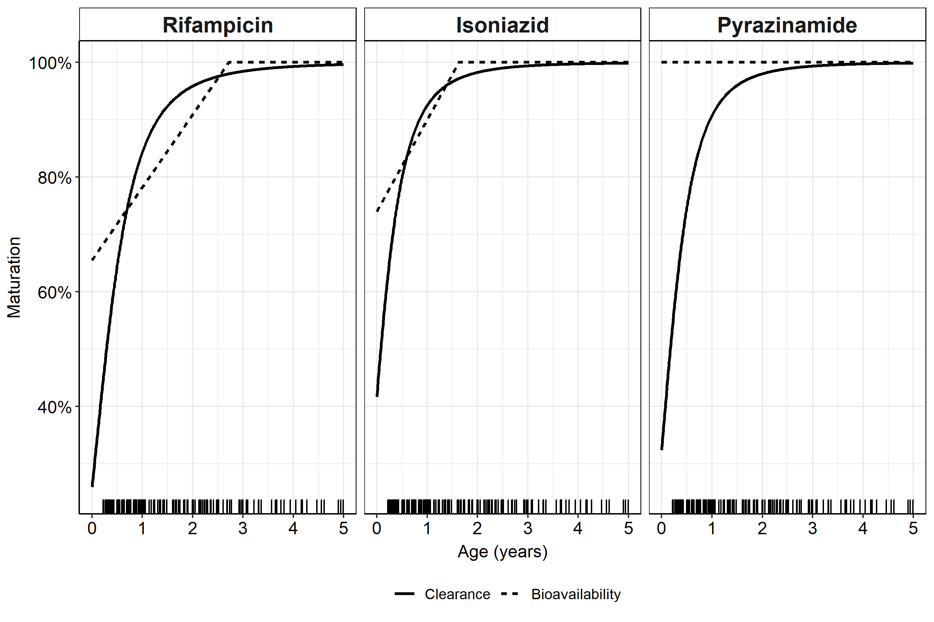
Maturation of Clearance and Bioavailability

Slide 13
Simulations
Focus on AUC – targeting adult exposures¹
Target
110,000 in-silico African children 3-25 kg
 | Reported medians | Chosen range
Rifampicin² (mg•h/L) | 13.5 – 72.9 | 38.7 – 72.9
Isoniazid³ (mg•h/L) | 11.6 – 26.3 | 11.6 – 26.3
Pyrazinamide³ (mg•h/L) | 233 – 429 | 233 – 429
Notes:
Target on adult exposure on standard dose
High dose rifampicin efficient and safe

Slide 14
Virtual population
Age, weight and height are correlated
WHO and CDC growth charts
Adjust
Fat-free mass (kg)
Age (years)
Age (years)
Notes:
Used data of >1200 children to make an age-dependent correction factor for African children living with HIV

Slide 15
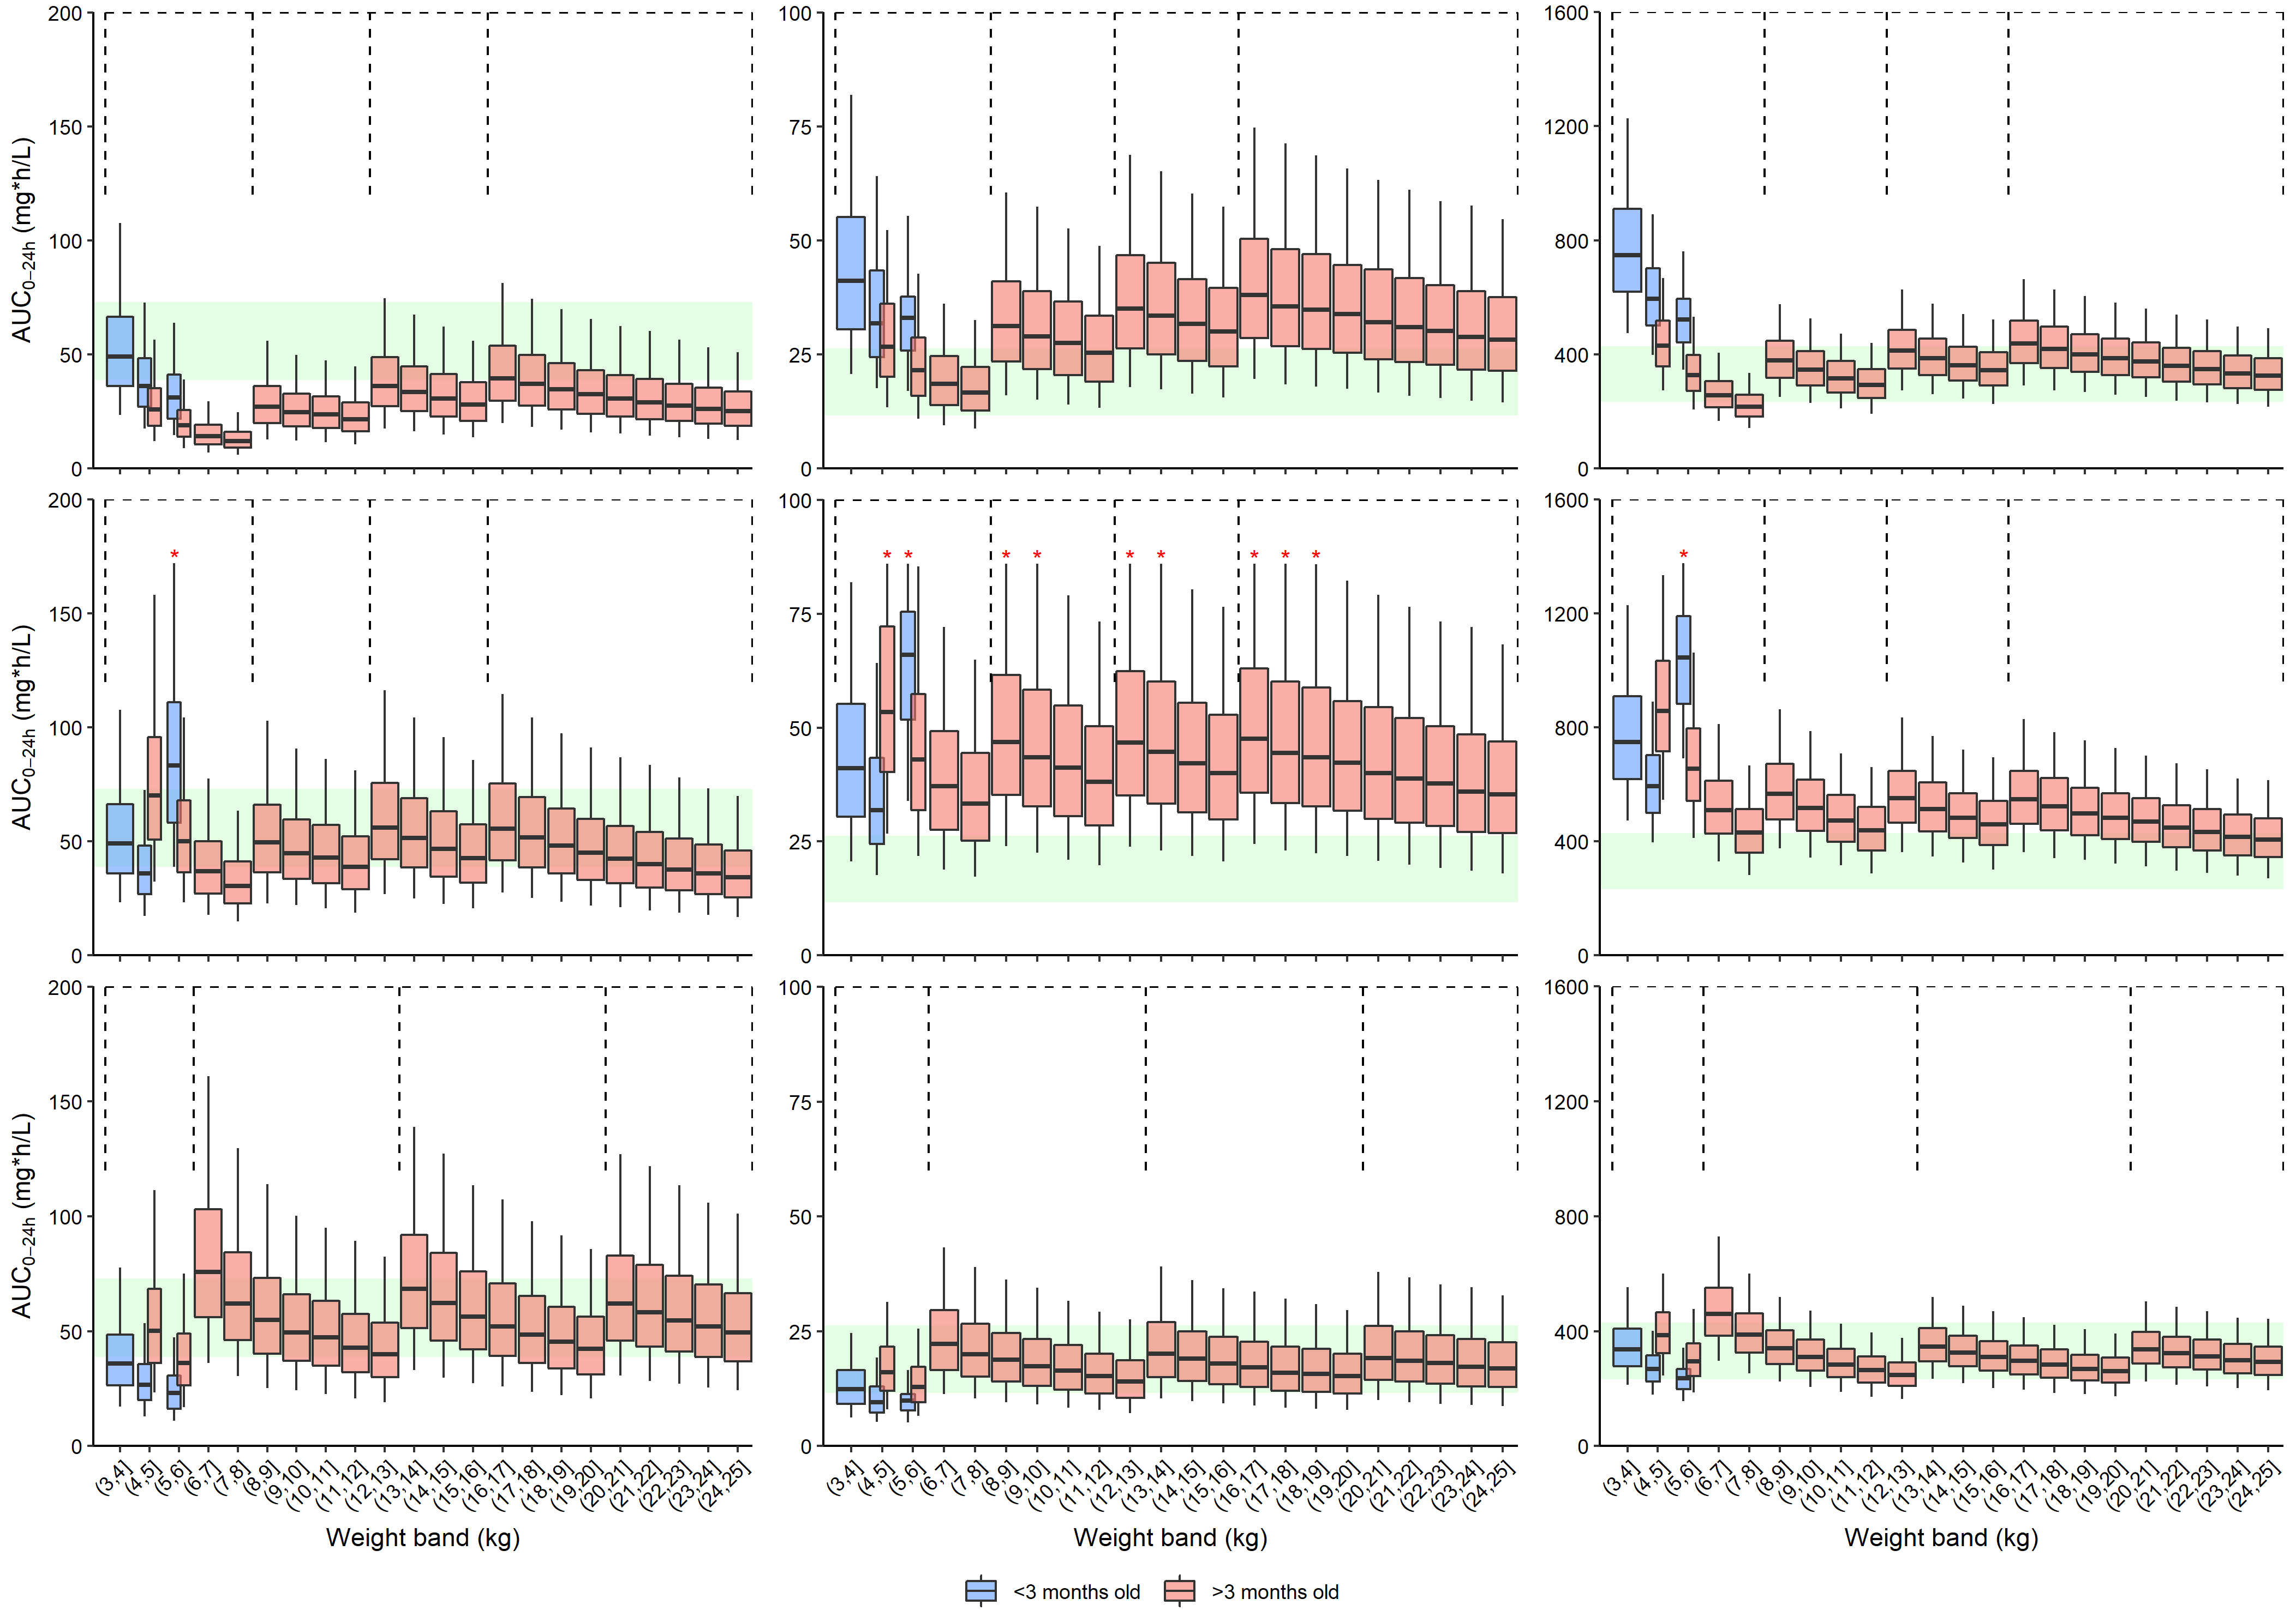
Results
Current FDC:
1 extra tablet
Notes:
RIF 38.73 - 72.94 mg*h/L,
INH 11.6 - 26.3 mg*h/L
PZA 233 - 429 mg*h/L

Slide 16
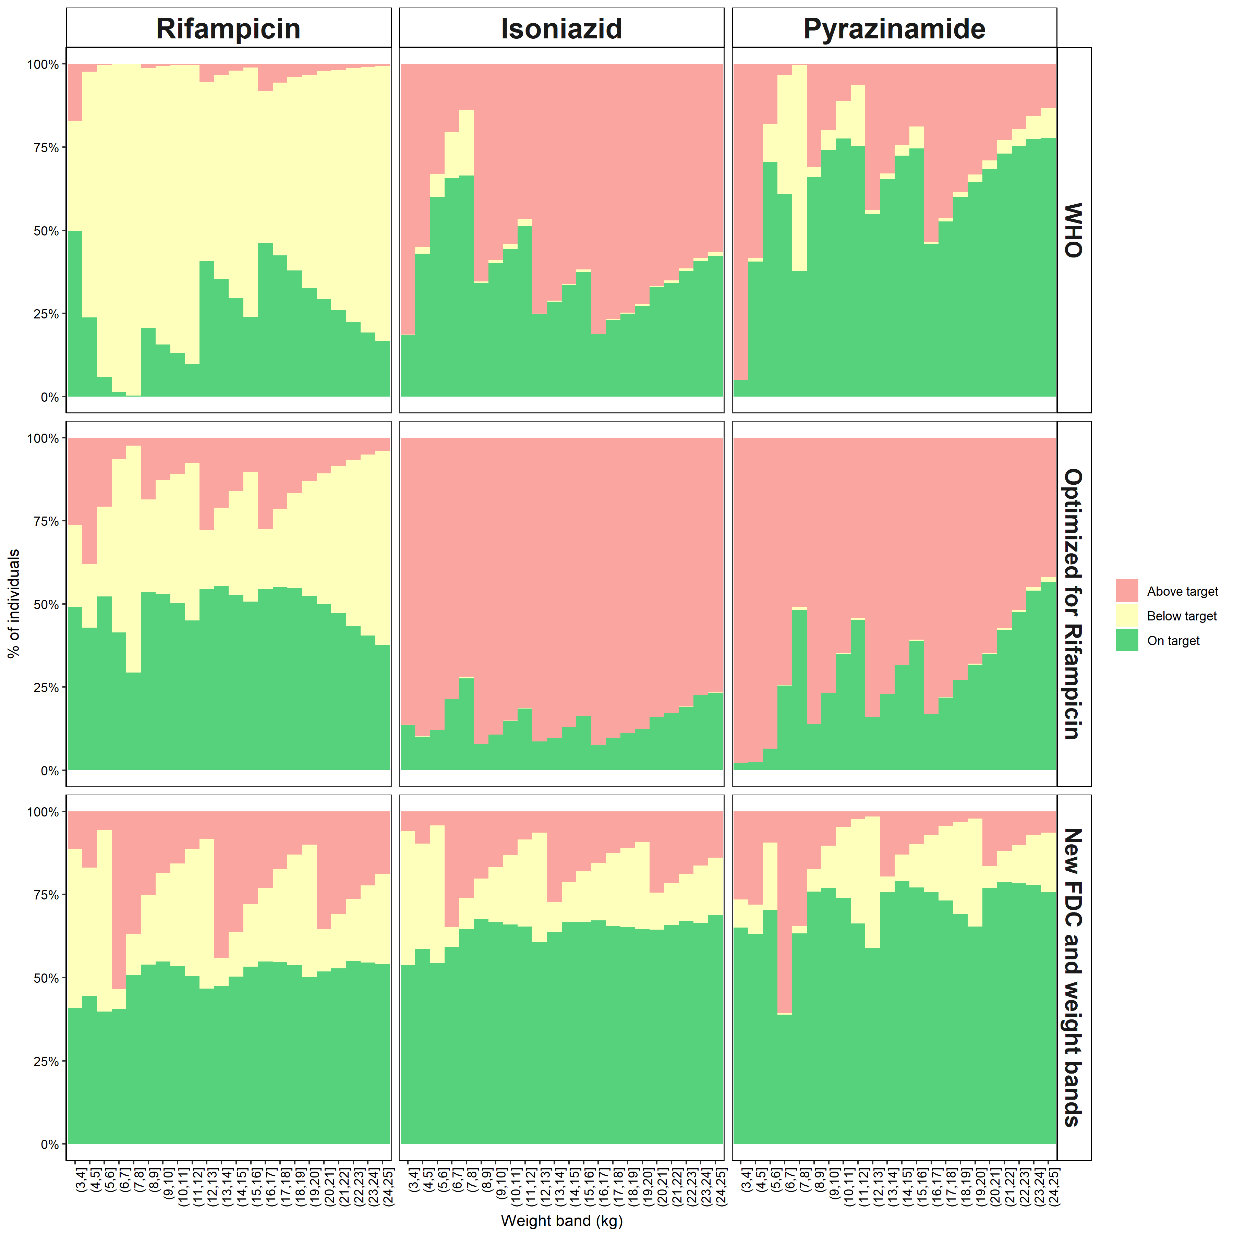
Percentage within target range
100
50
0
% of individuals
100
50
0
3
25
3
25
Weight band (kg)

Slide 17
Optimise FDC and weight bands
Notes:
Root mean square error
Not a continuous functions so we used a Logistic step function

Slide 18
Optimise FDC and weight bands
Estimate
Content of each of the 3 drugs
Weight bands for 1, 2, 3, and 4 tablets
Constraints
4 weight bands in total
½ tablet for children <3 months
Set of doses and weight bands
Simulate exposures (AUC)
Calculate deviation from target
Notes:
Not a continuous functions so we used a Logistic step function to estimate the break point for the weight bands

Slide 19
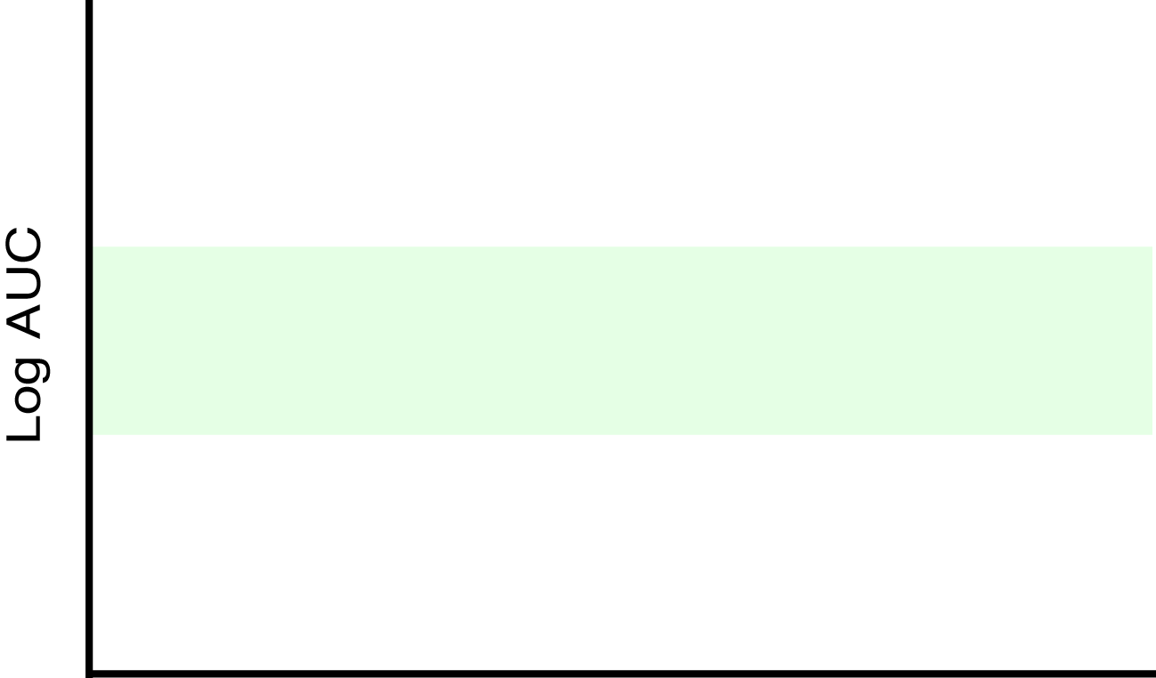
Optimise FDC and weight bands
Estimate
Content of each of the 3 drugs
Weight bands for 1, 2, 3, and 4 tablets
Constraints
4 weight bands in total
½ tablet for children <3 months
Deviation from target range
Penalty
No penalty
Penalty
Notes:
Root mean square error
Not a continuous functions so we used a Logistic step function

Slide 20
Exposure with new FDC and weight bands
Notes:
Rifampicin 120 mg Isoniazid 30 mg Pyrazinamide 135 mg
< 6 kg: 1 tablet 6-13 kg: 2 tablet 13-20 kg: 3 tablet 20-25 kg: 4 tablet

Slide 21
Conclusion
Rifampicin
Isoniazid
Pyrazinamide
100
50
WHO
0
Optimized
for
Rifampicin
Weight bands
FDC content
% of individuals
< 6 kg: 1 tablet 6-13 kg: 2 tablet 13-20 kg: 3 tablet 20-25 kg: 4 tablet
Rifampicin 120 mg Isoniazid 30 mg Pyrazinamide 135 mg
100
New FDC
and
Weight
Bands
50
0
3
25
3
25
Weight band (kg)
Notes:
WHO recommended doses result in low Rif exposures
Dose increase result in high Inh and Pza exposures
A new FDC (R/H/Z 120/30/135 mg) achieves exposures within the target range; potential of increasing efficacy and decreasing side effects
The development of a new FDC is likely to take a considerable amount of time. Therefore, a temporary solution could be to use the current FDC and top up the rifampicin dose with 75 mg (half a 150 mg rifampicin capsule) for each weight band.

Slide 22
Discussion
Method for design of FDC in one go
Procedure can easily be adapted (i.e., more weight bands, new or different targets, new models, more drugs)
The outcome of the optimization procedure is limited to user-chosen constraints
There are currently no clear PKPD targets
Result is dependent on the specific population
Notes:
FDC design happens only once in a decade so you cannot just thumb suck it, you need to put some science in.
Specific population (NAT2, stunted and wasted children, babies, uniformly distributed on age, weight or like a real TB population)

Slide 23
Acknowledgements
Participants and their care-givers
Study teams at
Malawi Liverpool Wellcome Trust and College of Medicine, Blantyre
Desmond Tutu TB Centre, Children’s Infectious Disease Clinical Research Unit
Department of Paediatrics and Child Health, Stellenbosch University
Red Cross Children’s Hospital, Cape Town
Co-authors
Paolo Denti, Annelies van Rie, Jana Winckler, Adrie Bekker, Helena Rabie, Anneke C. Hesseling, Louvina E. van der Laan, Carmen Gonzalez-Martinez, Heather J Zar, Gerry Davies, Lubbe Wiesner, Elin M. Svensson, Helen M. McIlleron

Slide 24
Additional slides

Slide 25
Model performance - Rifampicin

Slide 26
Model performance - Isoniazid

Slide 27
Model performance - Pyrazinamide

Slide 28
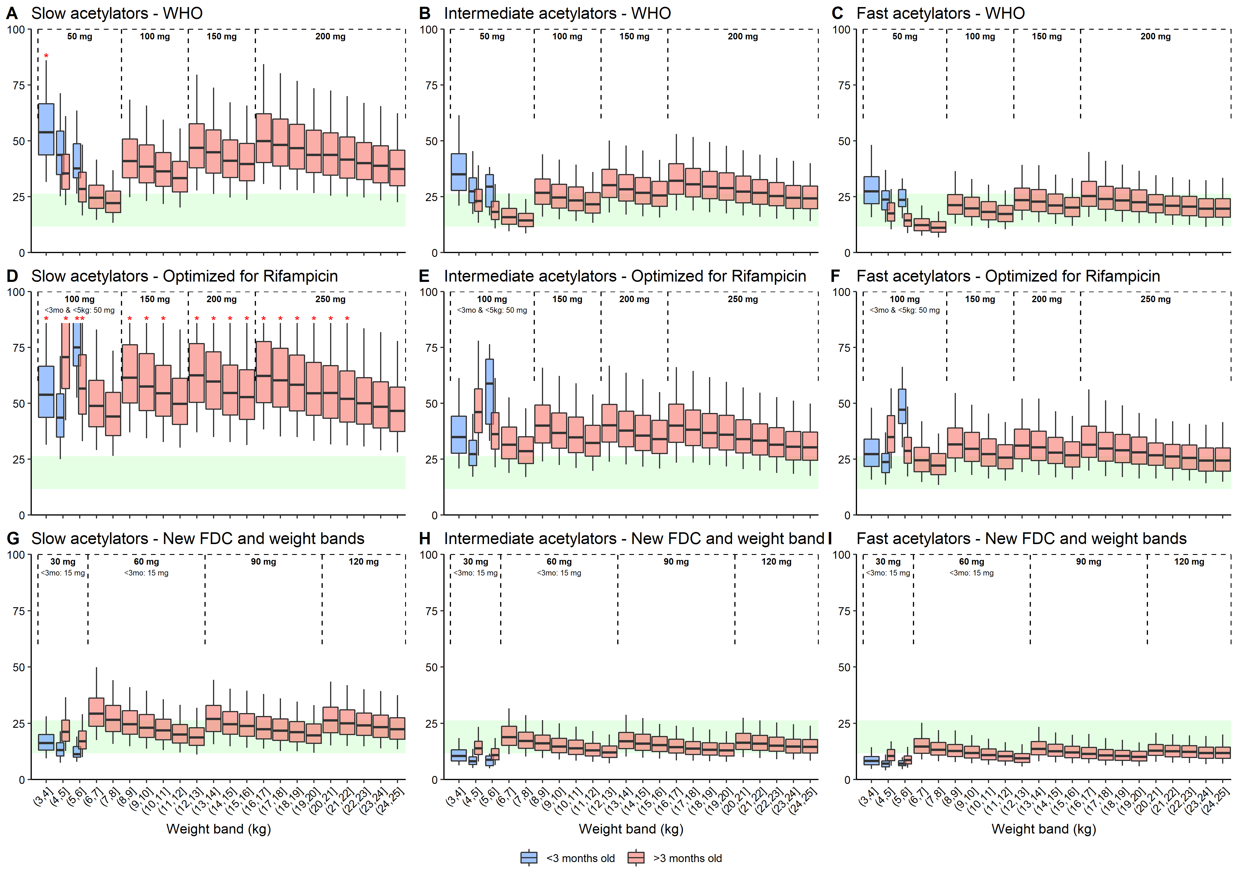
Per acetylator status

Slide 29
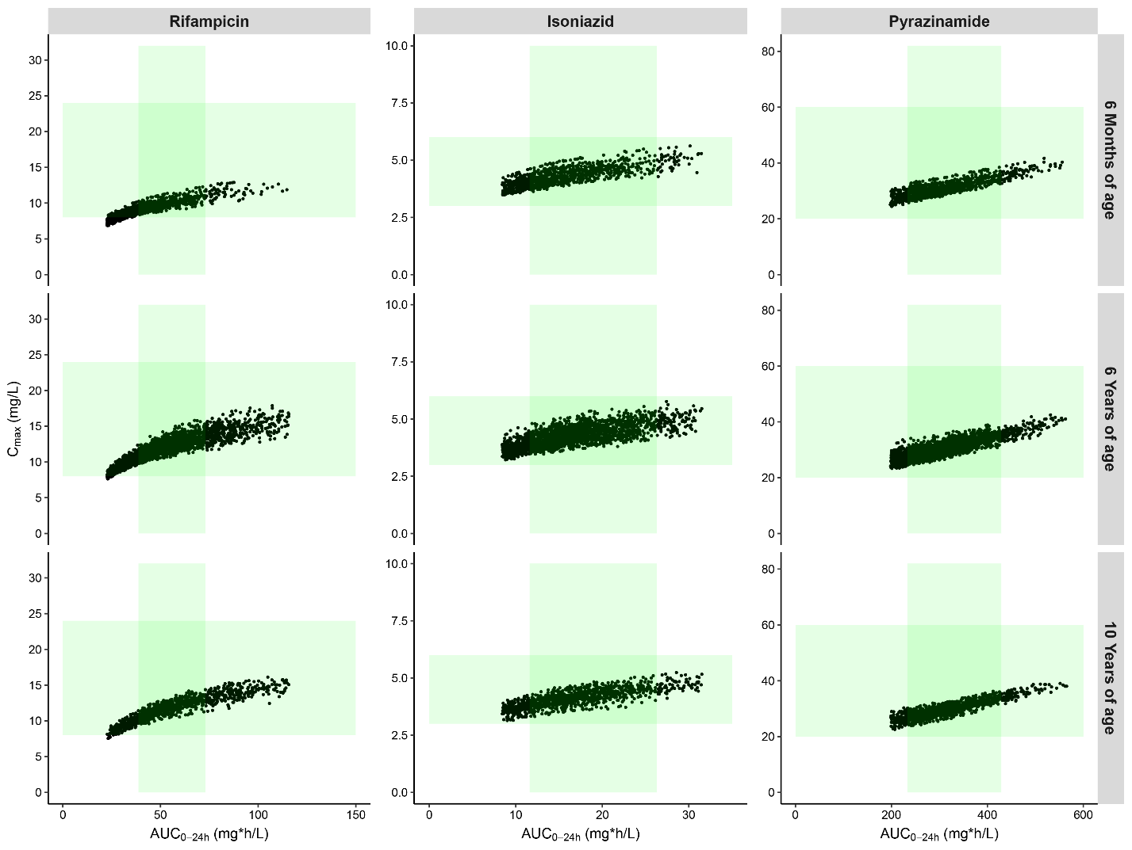
AUC versus C_{max}
Notes:
The vertical green shaded area is the target range based on AUC, as used in this work (i.e., 38.73-72.94 mg*h/L, 11.6-26.3 mg*h/L and 233-429 mg*h/L for rifampicin, isoniazid, and pyrazinamide, respectively.
The horizontal green shaded area represents the “normal” maximal concentrations after a standard dose as reported by Alsultan et al. Drugs 2014;74(8), 8-24 mg/L, 3-6 mg/L, and 20-60 mg/L for 600 mg daily rifampicin, 300 mg daily isoniazid, and 25-35 mg/kg daily pyrazinamide, respectively.

Slide 30
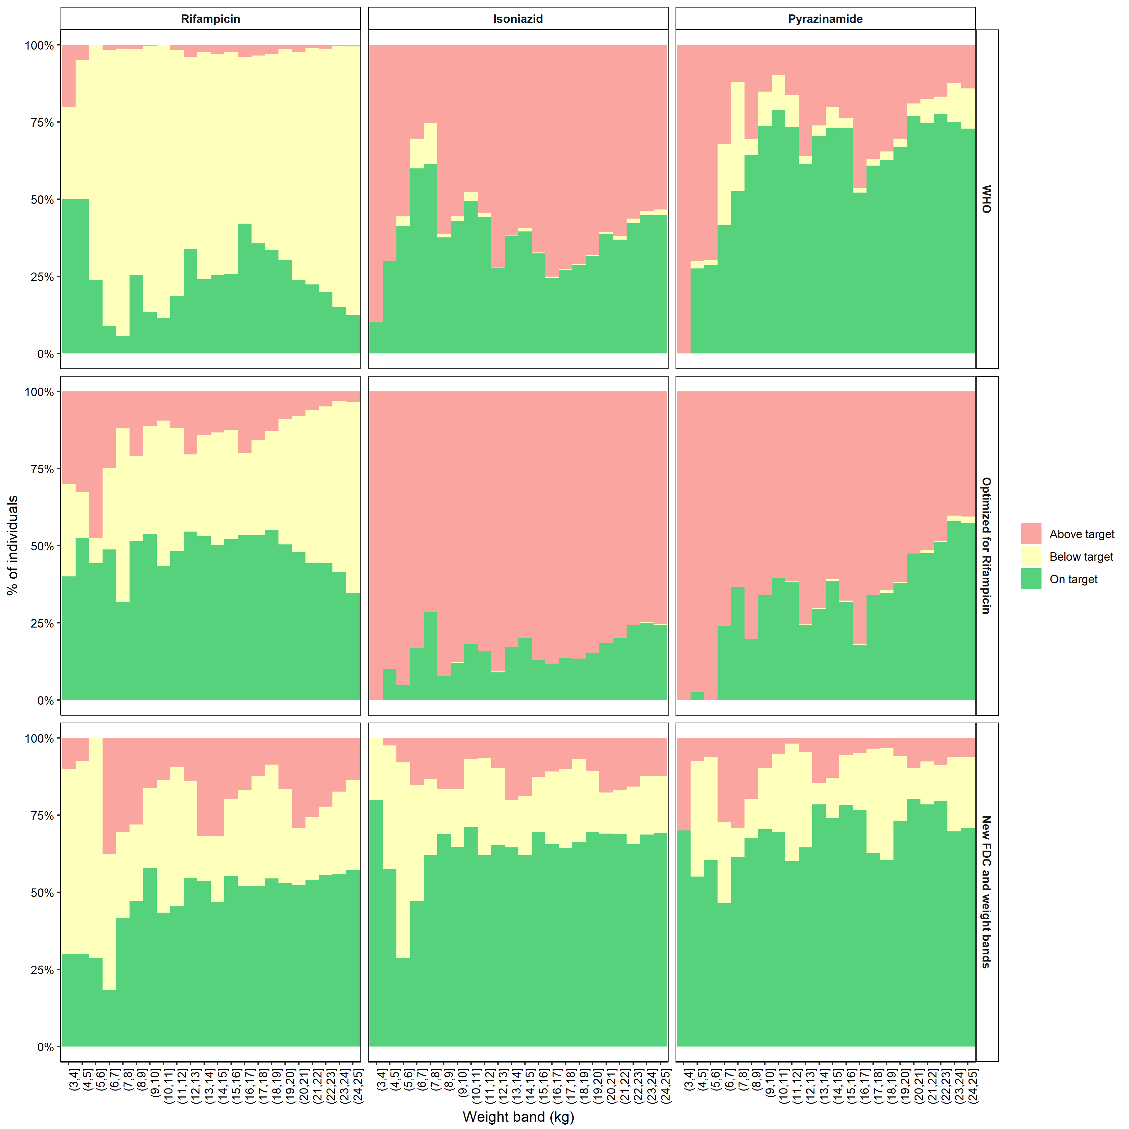
In a real Kenyan population

Slide 31
Logistic function

