Slide 1
Virtual patient simulation: a copula approach
Laura B. Zwep – Stuart Beal Methodology Session

Slide 2
Covariate simulation in pharmacometrics
PK or PD
data
pharmacometric model
simulations
treatment optimization
covariates
virtual patient simulation
How do we simulate realistic patient covariate sets?

Slide 3
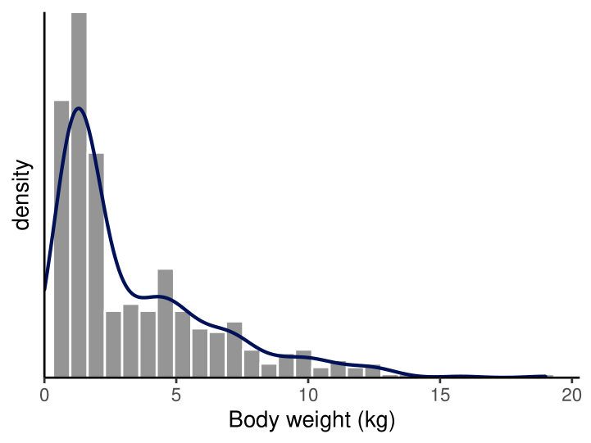
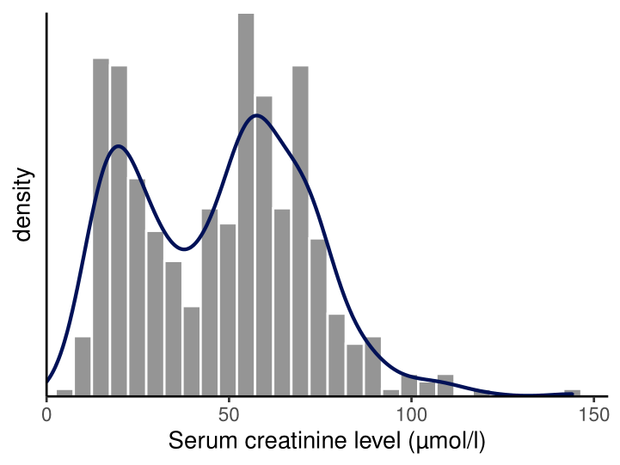
Covariates
For covariates $X_{1}$ and $X_{2}$
Marginal densities: $f_{1}(x_{1})$ and $f_{2}(x_{2})$

Slide 4
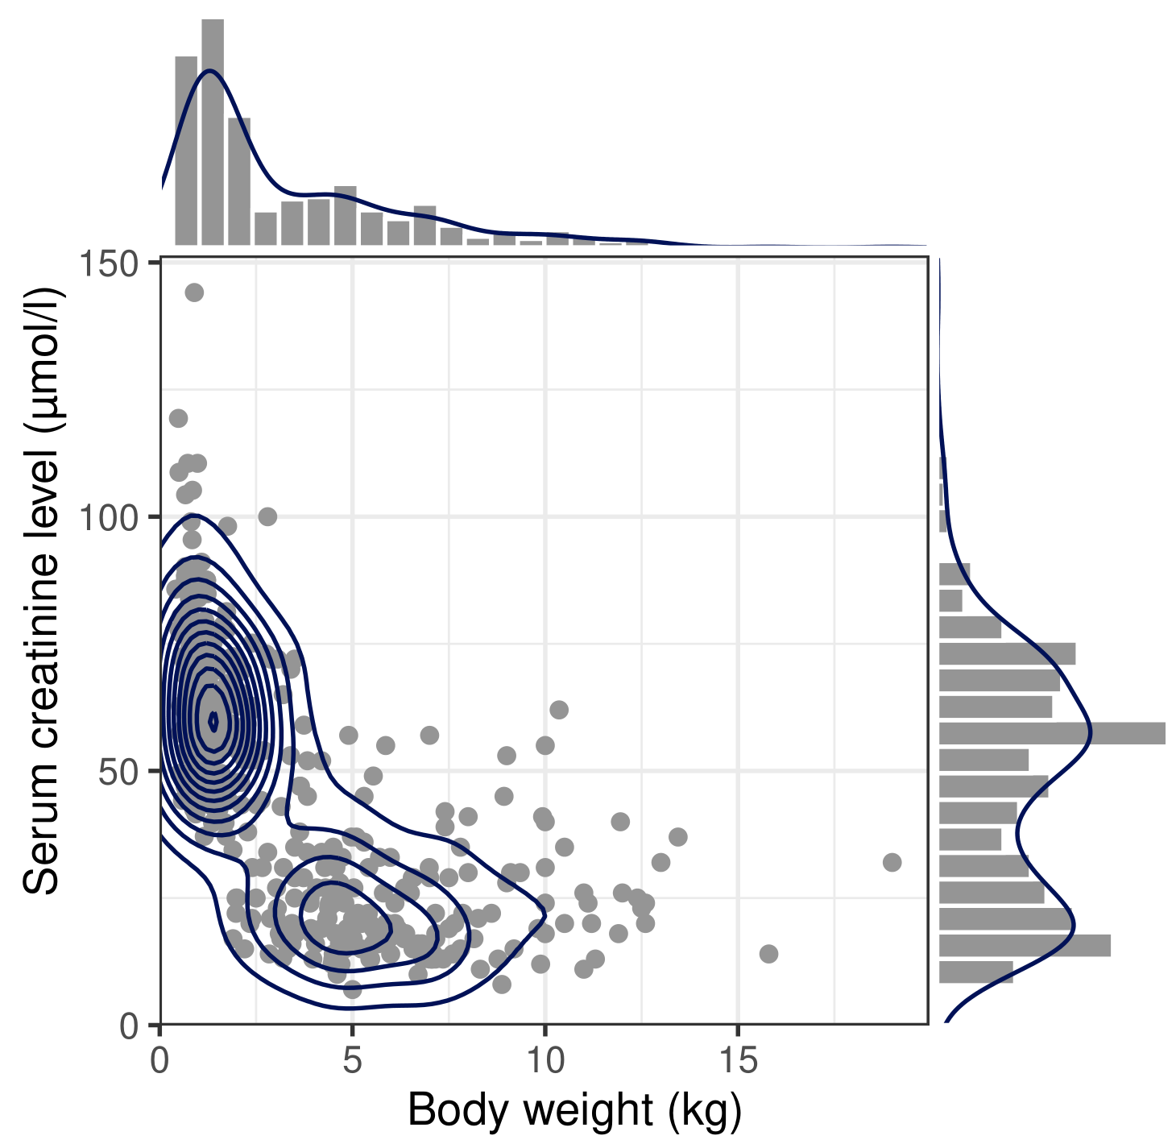
Covariates: dependence structure
For covariates $X_{1}$ and $X_{2}$
Marginal densities: $f_{1}(x_{1})$ and $f_{2}(x_{2})$
Joint density distribution: $f\left(x_{1}, x_{2}\right)$
realistic patients come from this joint distribution

Slide 5
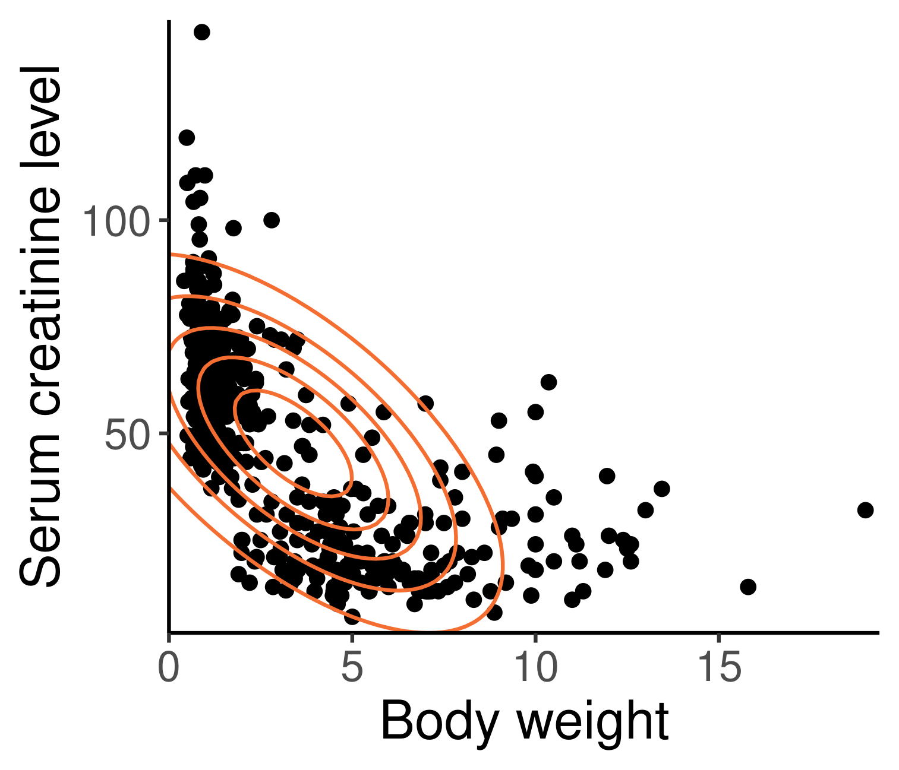
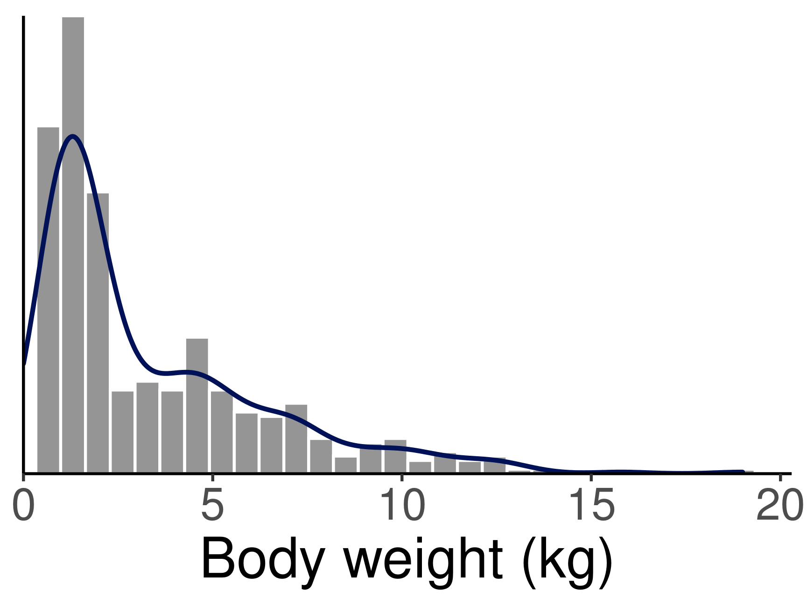
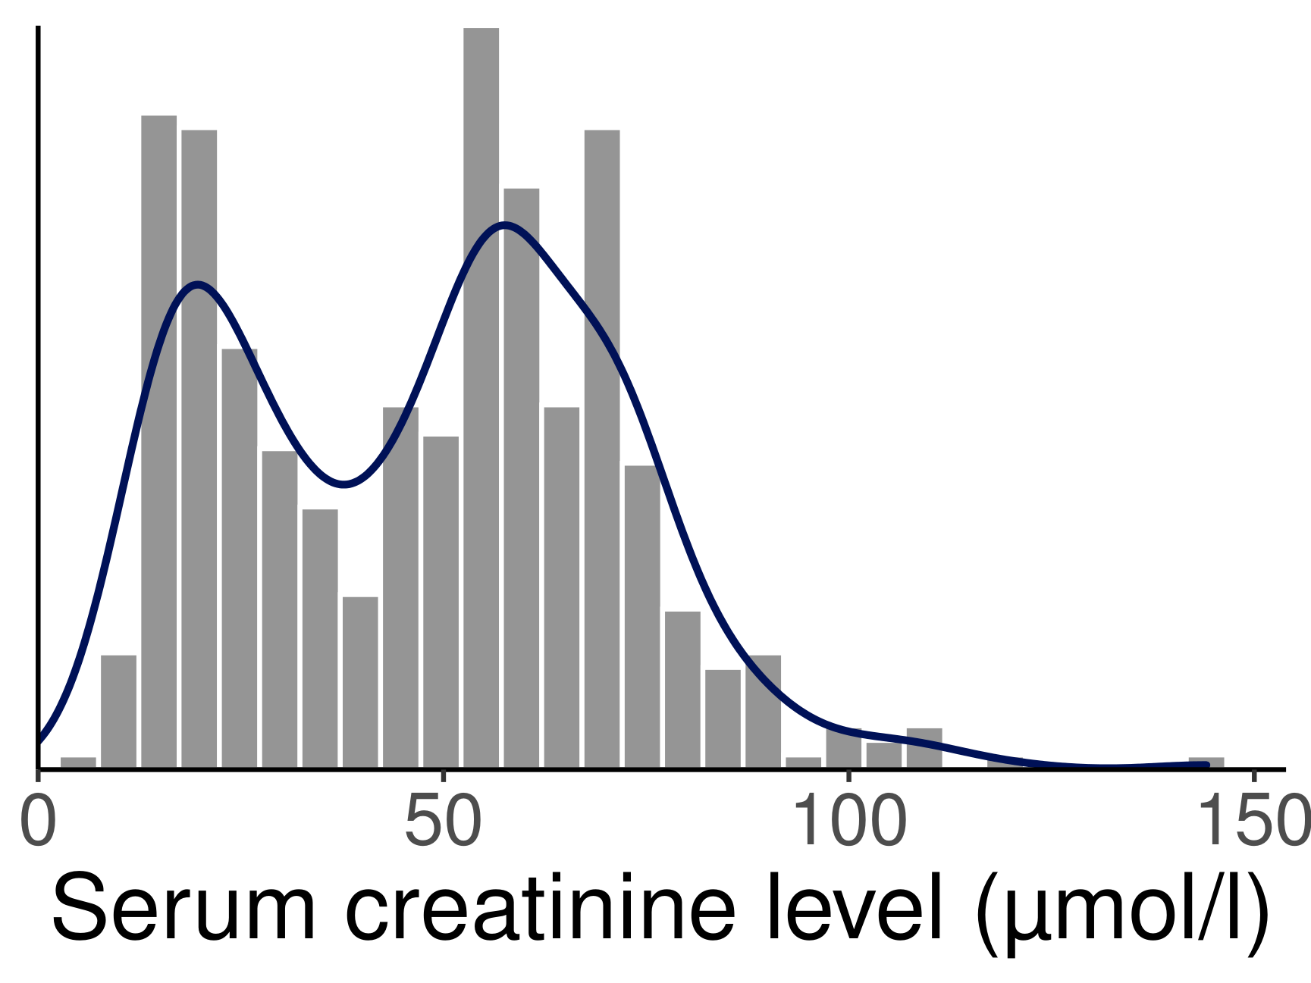
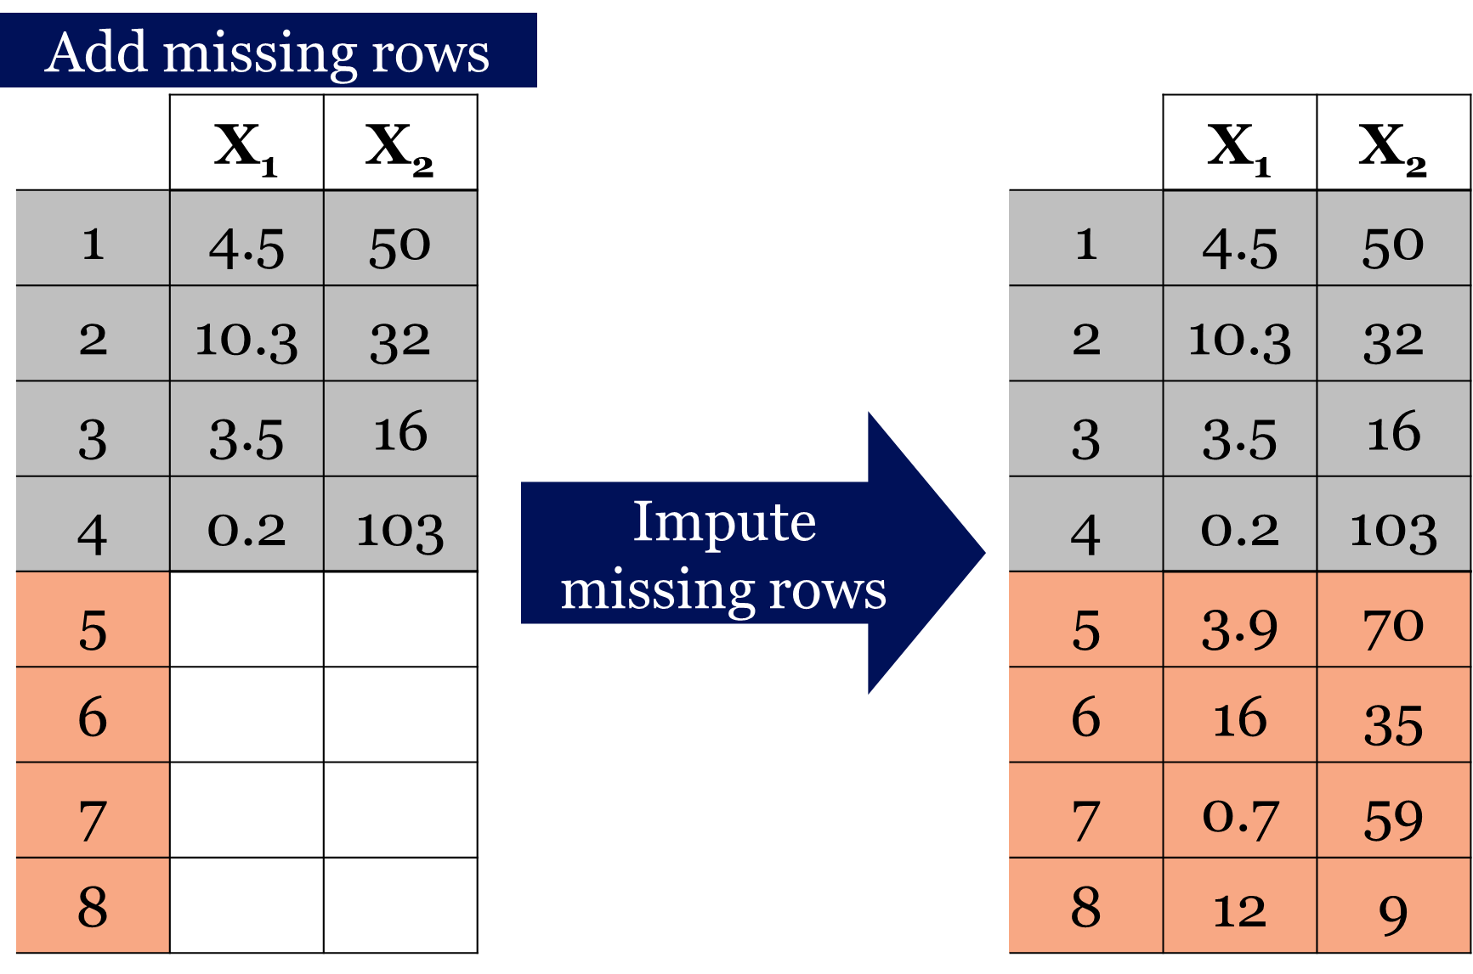
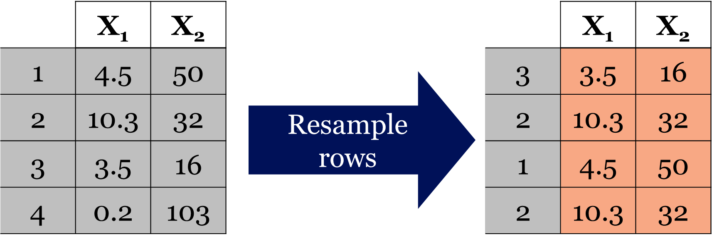
Current simulation methods
Marginal distributions
Multivariate normal distribution
distribution-based
Bootstrap
Conditional distributions (MICE)
Smania & Jonsson, 2021
data-based

Slide 6
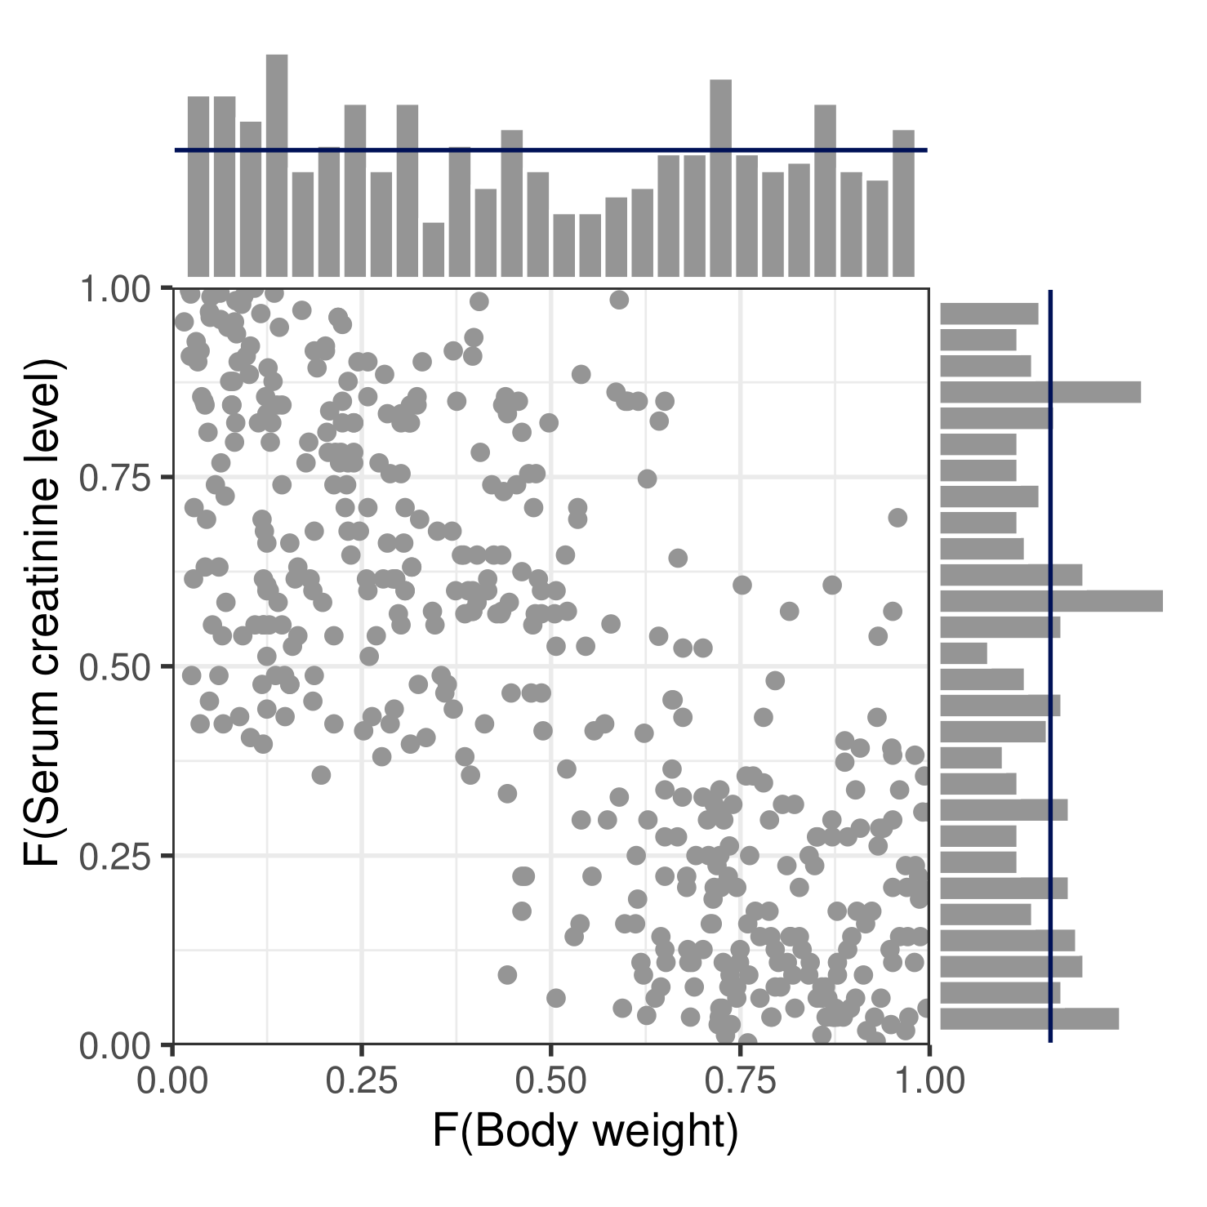
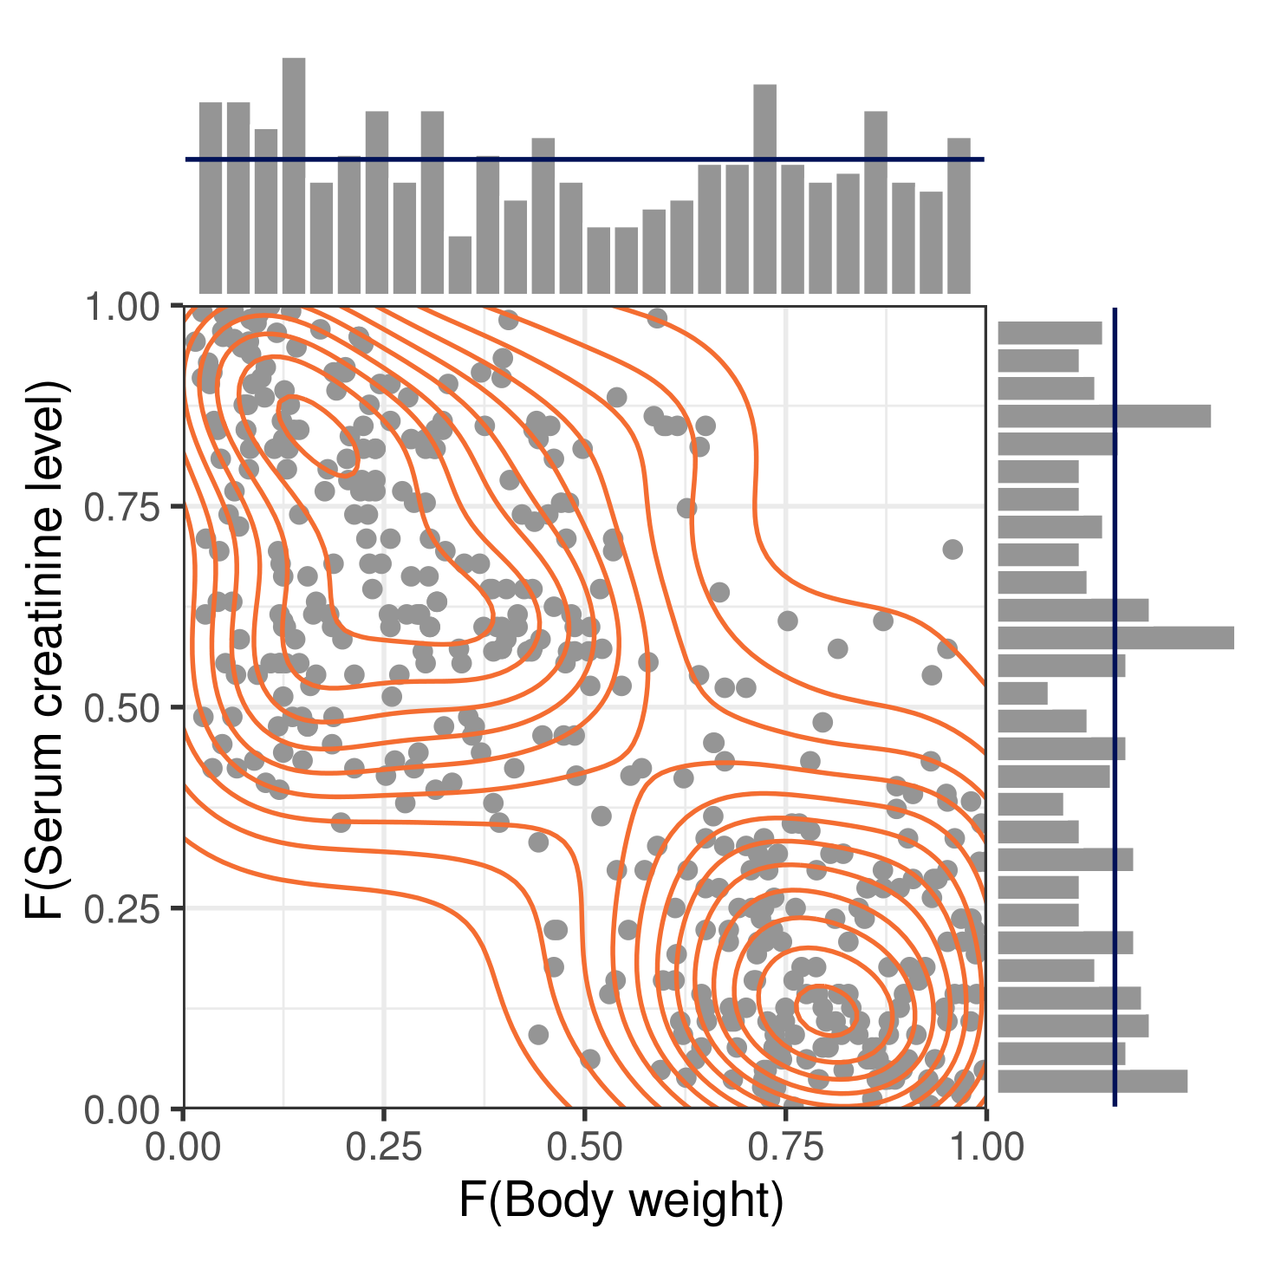
Copula
Density of the dependence structure between two uniformly distributed covariates
Transform marginals to uniform
Inverse density:
$F_{1}(X_{1})\sim U(0,1)$ and $F_{2}(X_{2})\sim U(0,1)$
Joint density:
$f\left(x_{1}, x_{2}\right)=f_{1}\left(x_{1}\right)∙f_{2}(x_{2})∙c\left(F_{1}\left(x_{1}\right),F_{2}\left(x_{2}\right)\right)$
copula density

Slide 7
Research aims
How realistic are simulated patients from a copula model?
performance of different simulation techniques
covariate distributions
PK profiles
applications of covariate simulations
time-dependent covariates
scaling up to large data

Slide 8
Covariate simulation performance
Compare covariate distributions
copulas, conditional and marginal distribution
data Cock, et al. (2014)
pediatric: neonates and children
12 covariates
445 patients
simulation of 3 covariates
simulation of 12 covariates
statistics (𝑆): covariance, mean, standard deviation
$error= (S−\hat{S})/S$

Slide 9
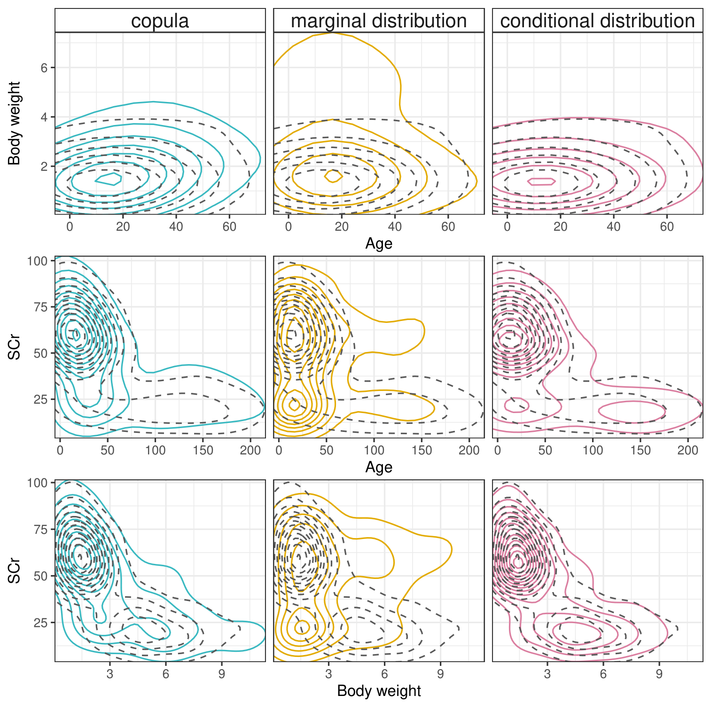
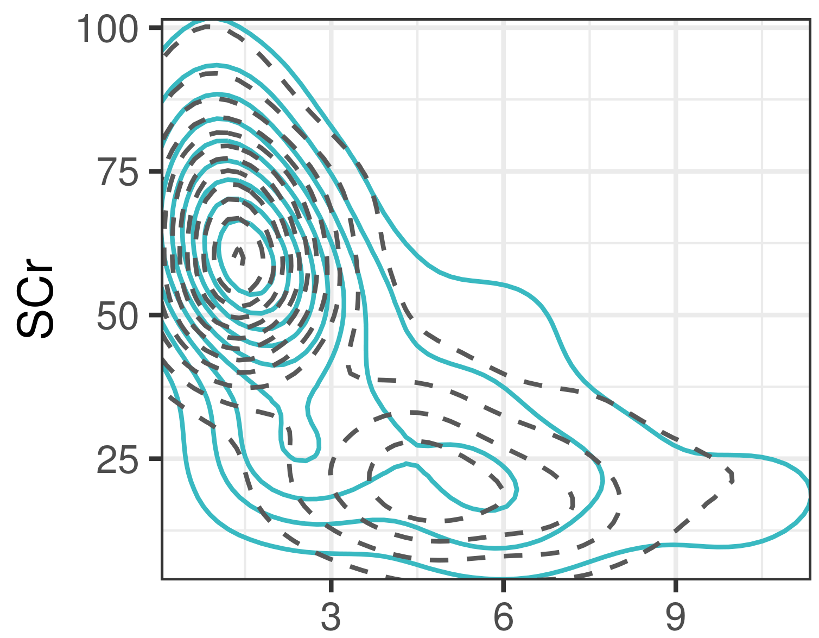
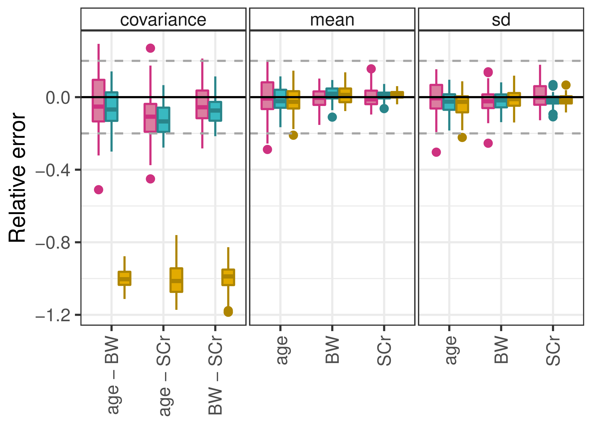
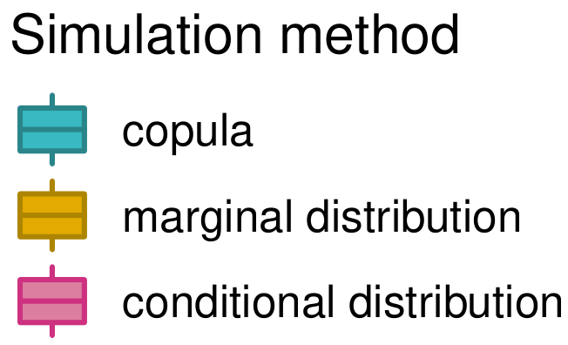
Simulated distributions in 3 dimensions

Slide 10
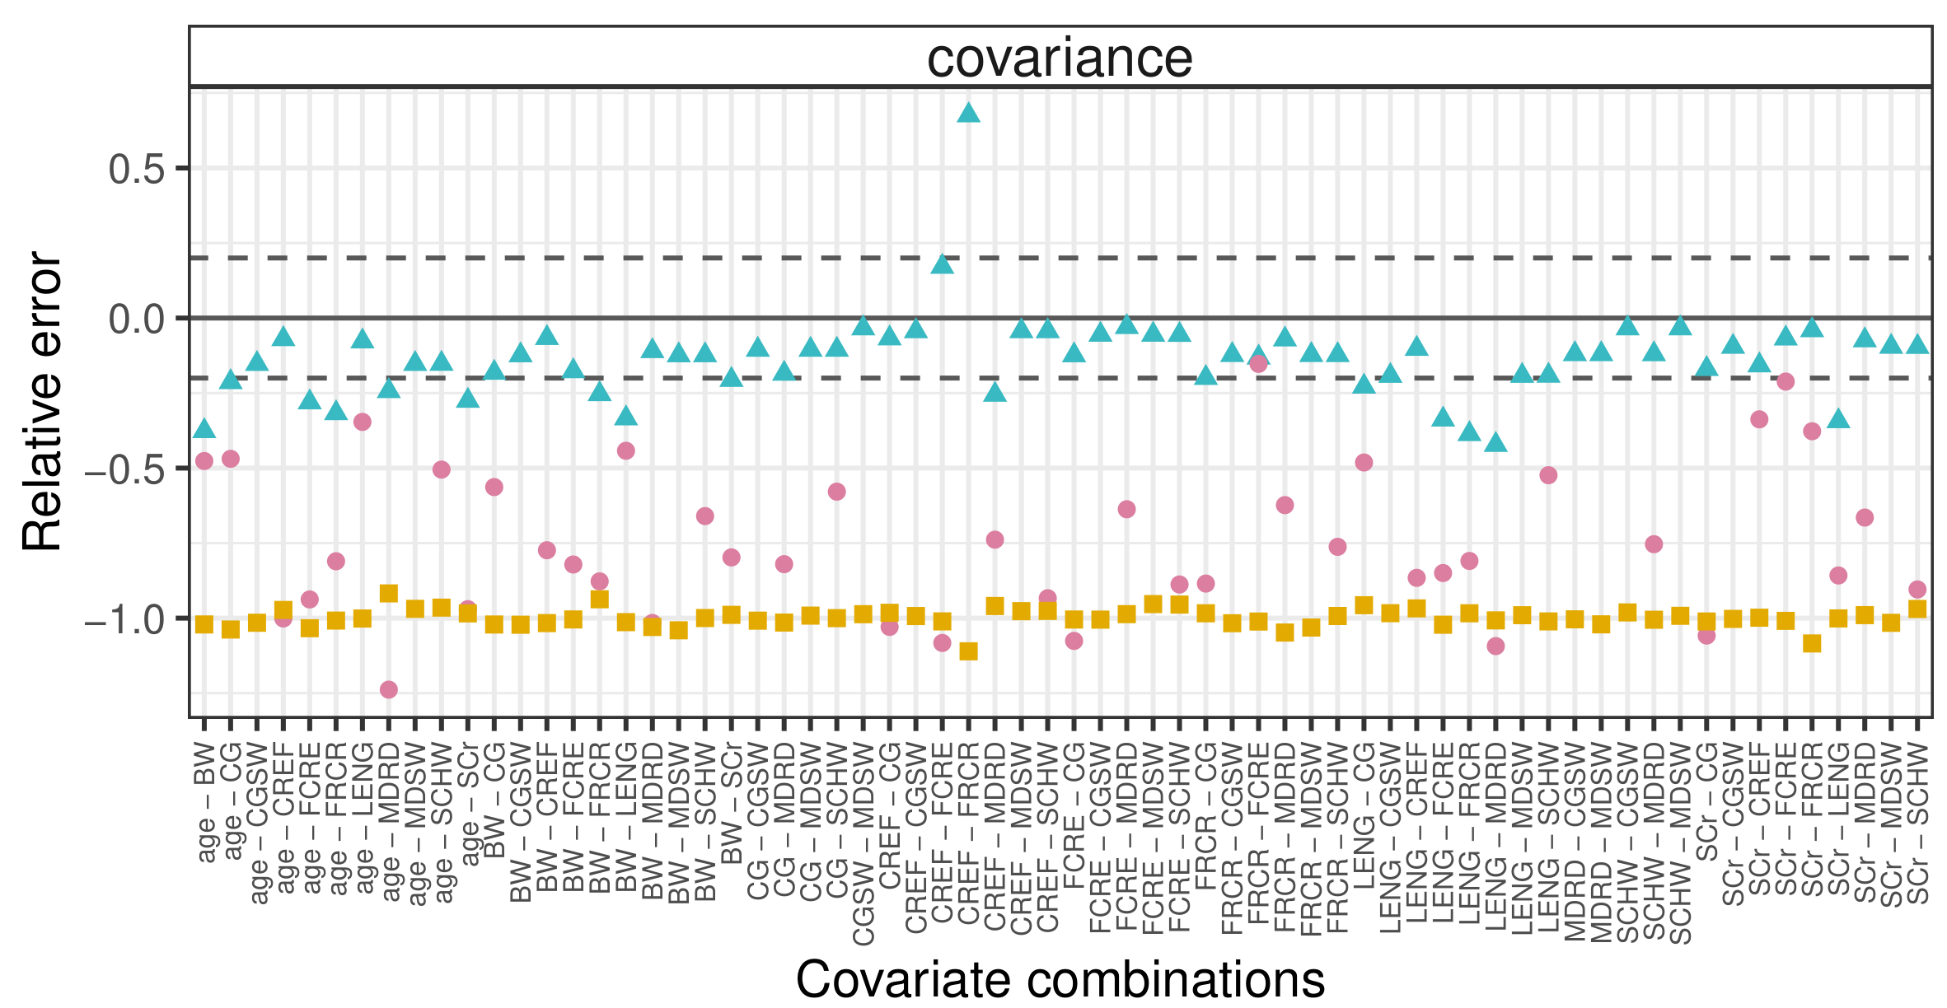
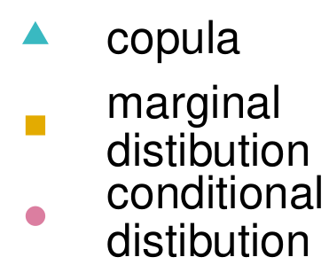
Simulated distributions in 12 dimensions

Slide 11
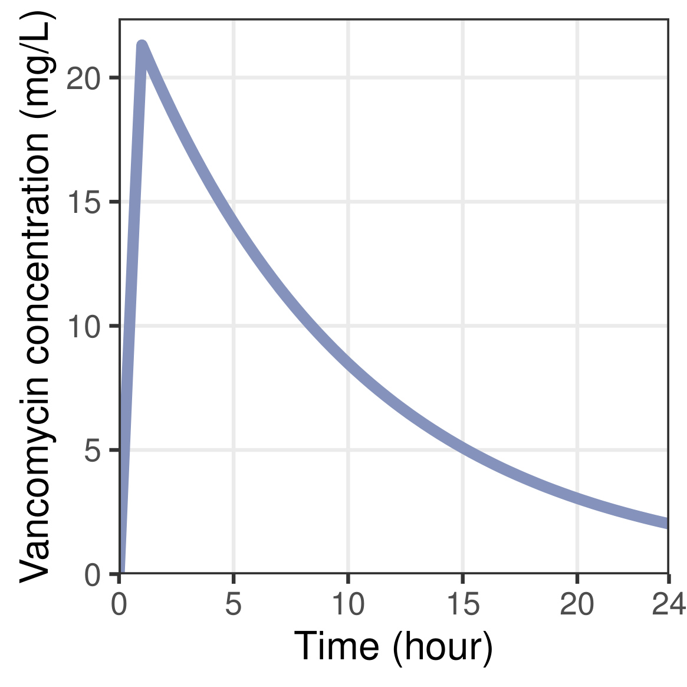
Covariate simulation performance
literature Grimsley & Thomson (1999)
Compare covariate distributions
copulas, conditional and marginal distribution
vancomycin PK model
$$k_{a}$$
$$V_{D}(WT)$$
$$Cl(WT, SCr)$$
data Cock, et al. (2014)
pediatric: neonates and children
12 covariates
445 patients
simulation of 3 covariates
calculate PK
simulation of 12 covariates
evaluate covariate/PK correlations
statistics (𝑆): covariance, mean, standard deviation
$error= (S−\hat{S})/S$

Slide 12
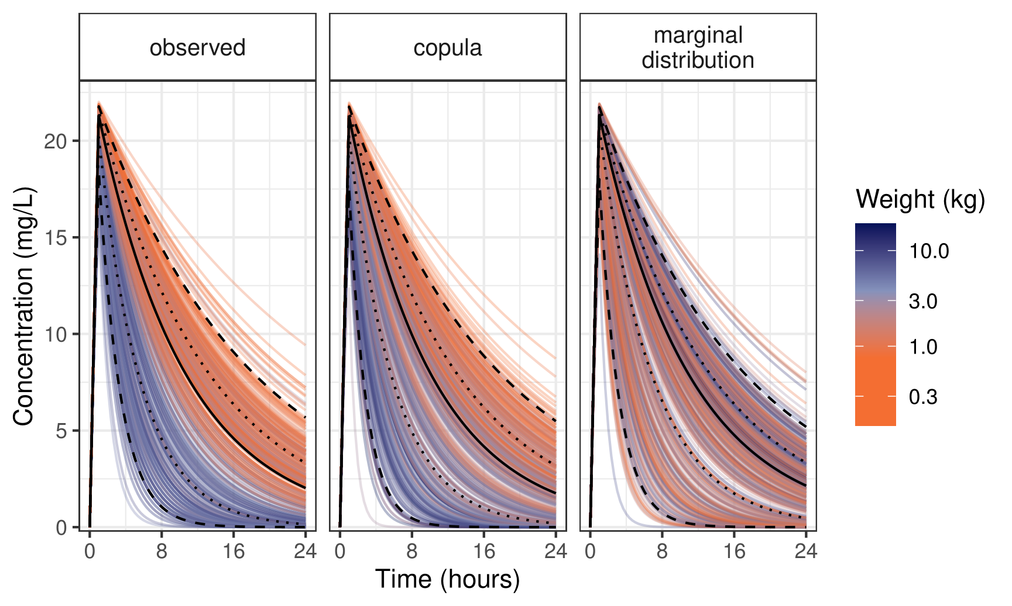
Pharmacokinetic predictions
$$k_{a}$$
$$V_{D}(WT)$$
$$Cl(WT, SCr)$$

Slide 13
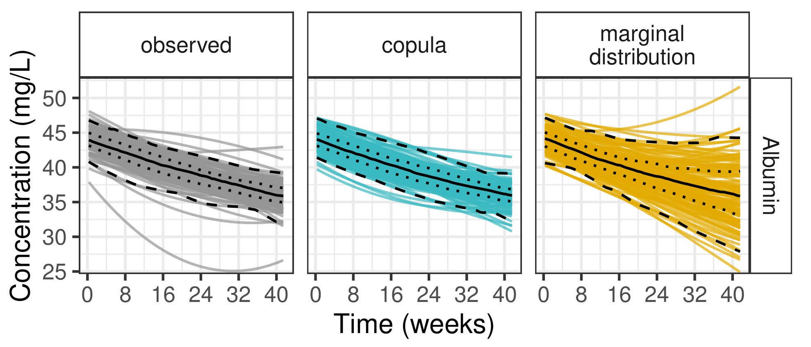
Time-dependent covariates
data Patel, et al. (2013)
Mixed effect model
fit polynomial mixed effect model
extract individual parameters
pregnancy, 123 subjects
6 longitudinal covariates: e.g. albumin, bilirubin
$\sim$14 measurements
Simulation
simulate individual parameters
calculate curves

Slide 14
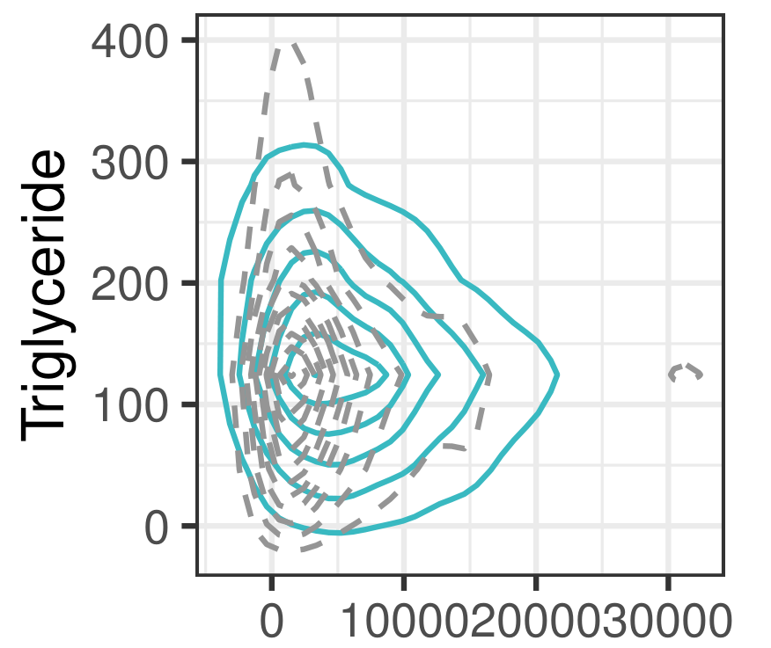
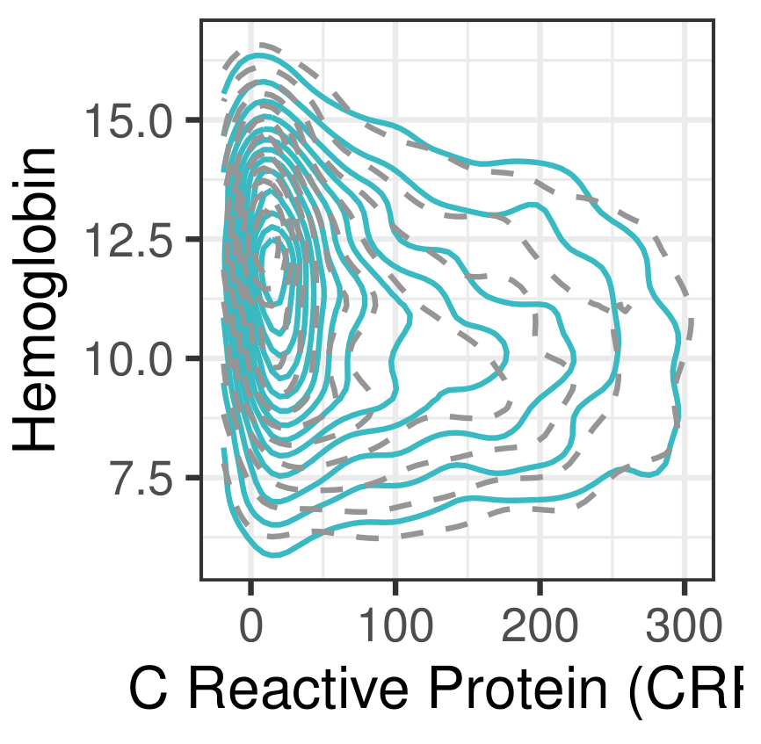
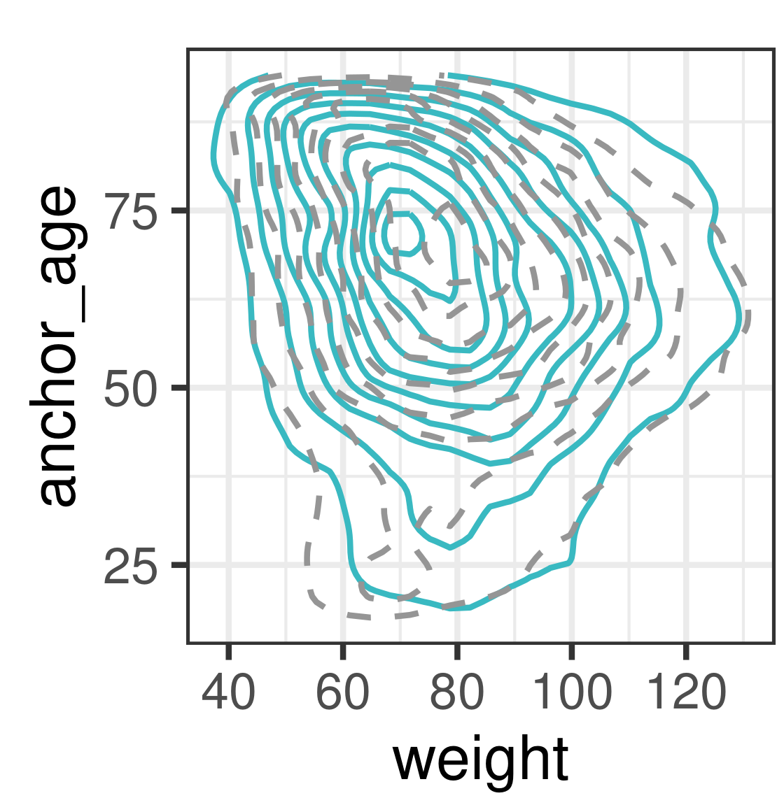
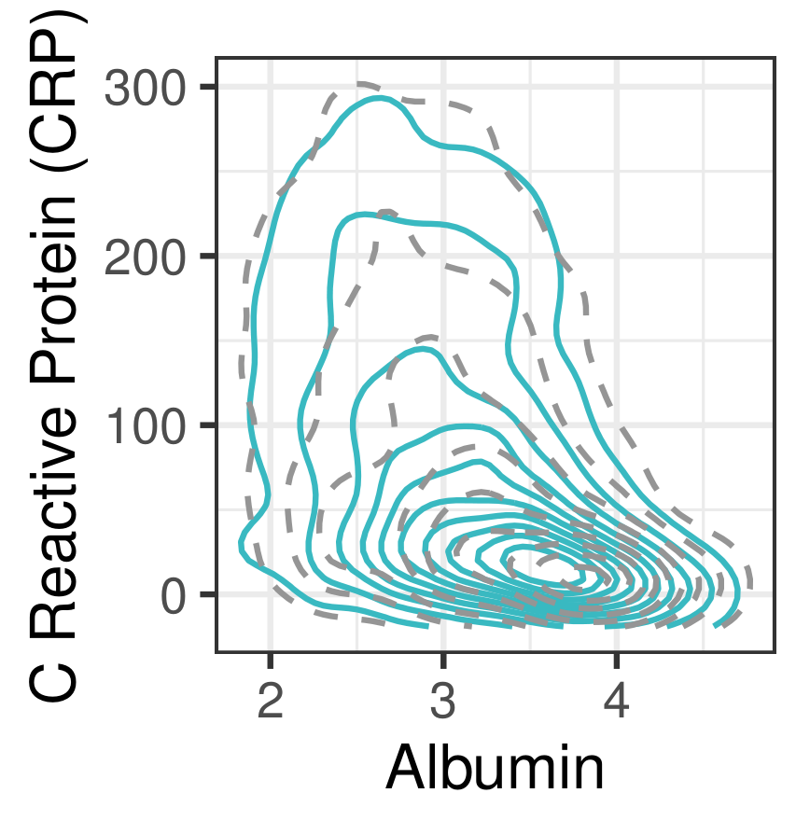
Upscaling: large data copula
Bad fit:
data Johnson, et al. (2022)
Simulation
fit copula
simulate patients
MIMIC: ICU patients
30 covariates
>53.000 patients
Brain Natriuretic Peptide
Good fits:

Slide 15
Conclusion
Please let us know if you want to collaborate on creating virtual patient populations!
l.b.zwep@lacdr.leidenuniv.nl
coen.vanhasselt@lacdr.leidenuniv.nl
Copulas
can simulate realistic patients
are distribution-based
can be used to share distributions

Slide 16
Thank you for your attention!
Acknowledgements
Please let us know if you want to collaborate on creating virtual patient populations!
l.b.zwep@lacdr.leidenuniv.nl
coen.vanhasselt@lacdr.leidenuniv.nl
Coen van Hasselt (LACDR)
Jacqueline Meulman (LUXs data science)
Tingjie Guo (LACDR)
Thomas Nagler (LMU Munich)
LACDR – Systems Pharmacology and Pharmacy division

