Slide 1

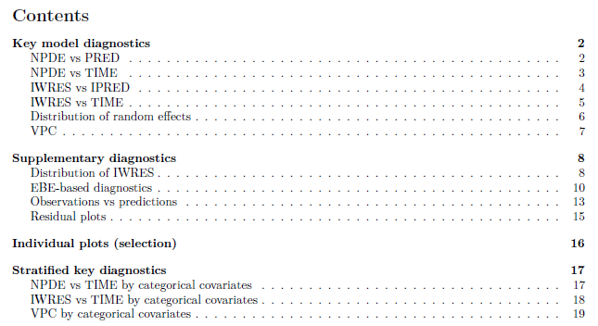
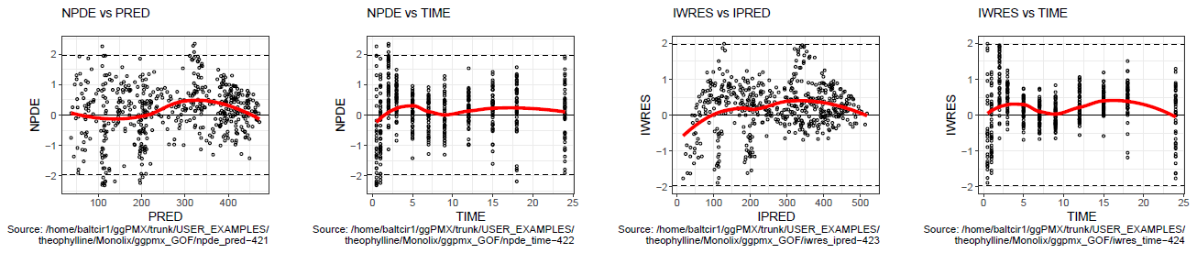
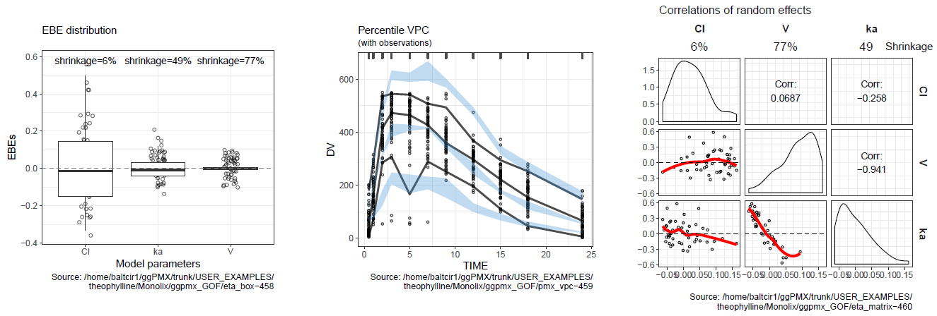
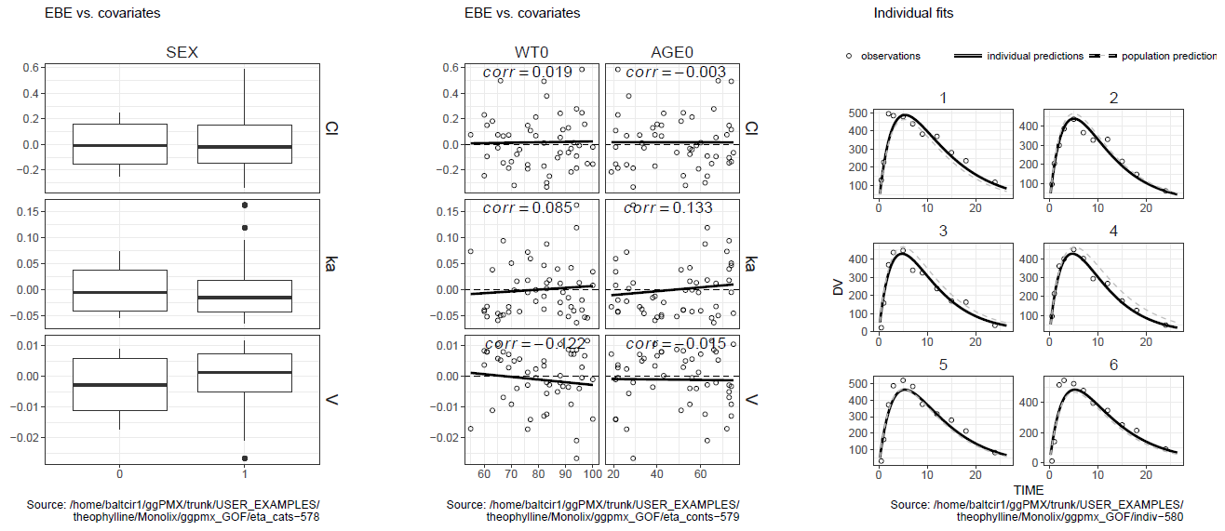
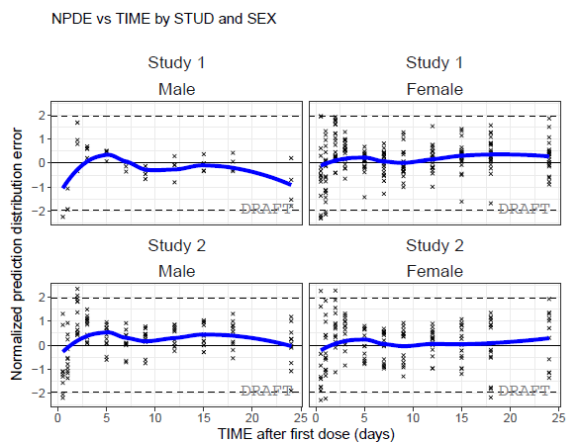
ggPMX: an open-source R package for pharmacometric model diagnostic plots
I-30
I. Baltcheva¹, C. Bartels¹, T. Dumortier¹, S. Bhattacharya², I. Paule¹, I. Ludwig¹, I. Demin¹, A. Gassem³, D. Renard¹, B. Bieth¹
¹Pharmacometrics, Novartis, Basel, Switzerland; ²Pharmacometrics, Novartis Inst of Biomedical Research Inc, Cambridge, USA; ³AG-Sudy, 18 rue Philibert Lucot, 75013 Paris, France
Key features of ggPMX
Open-source R package based on ggplot2, freely available on CRAN
Library of diagnostic plots needed for nonlinear mixed-effects model building and validation
Enables a consistent, reproducible and efficient workflow
High quality graphics, ready-to-use in submission documents and publications
Optimal figure customization and graphics stratification
Straightforward generation of PDF, Word or PNG output files for keeping track of modeling results
Currently compatible with Monolix versions 2016 and 2018R1
Architecture
The implementation of ggPMX uses object-oriented programming, which allows having code that is modular and easy to customize. The architecture consists of the following four components:
Reader - reads model outputs from different sources (i.e. text files containing population parameters, model predictions, individual random effects, simulations and data-related inputs like covariates) and restructures these outputs into standard formats, which can be easily processed by the Generator.
Generator - processes outputs from Reader and produces the diagnostic plots. A set of default plots is defined in a configuration file. The configuration file can be adapted, e.g., to have different configurations for different types of modeling activities (health authority submission, publication, internal report).
Controller - serves as user interface. The user will call Generator functions via the Controller to produce either the default plots or customized versions.
Reporter - generates sets of graphs and tables as individual PNG files and integrates them all into one single output document (Word or PDF) with annotations pointing to the locations of the individual PNG files. The report generation is based on Rmarkdown, which enables the user to create his own report template.
Code
# Initiate ggPMX Controller:
ctr <- pmx(sys = "mlx", config = "standing", directory = work_dir, input = input_data, dv = "Y", dvid = "DVID")
# Generate mini-report with model diagnostics:
ctr %>% pmx_report(name = "my_report", output_type="report", save_dir = "some_location", footnote = TRUE)
Generates PDF/word document
Key diagnostics, annotated with file location
Figure 1. Use of ggPMX package
Guidance
Good practices for model building, evaluation and qualification
A few lines of R-code
Mini-report with default diagnostics
Project specific adjustments of template or configuration
Plot configuration
&
Report template
+
ggPMX package
Customized mini-reports with diagnostics for publication
Available plots
Using simple syntax, the toolbox produces various model diagnostics that can be customized by adjusting graphical parameters and by applying various stratifications by covariates
                Individual plots
                Residual-based plots
                Empirical Bayes estimate (EBE)-based plots
                Distribution plots
                Prediction- and simulation-based diagnostics (visual predictive checks)
                Shrinkage
                Summary parameters table
Summary
The ggPMX R package generates standard diagnostic plots for mixed effect models used in pharmacometric activities. The tool is built upon ggplot2 and currently supports models developed with Monolix 2016 and 2018R1. Future plans are to make ggPMX compatible with nlmixr and NONMEM outputs. ggPMX is now ready for inputs and enhancements by the pharmacometrics community.
Customization
Change time axis label in some or all plots
Zoom into a time period (filtering)
Stratification by study and sex
Change attributes of loess line and of data points
Add DRAFT label
....
Disclosures
Poster presented at Population Approach Group Europe (PAGE), June 11 to June 14 2019, Stockholm, Swiden. This project was sponsored by Novartis Pharma AG.

