Slide 1
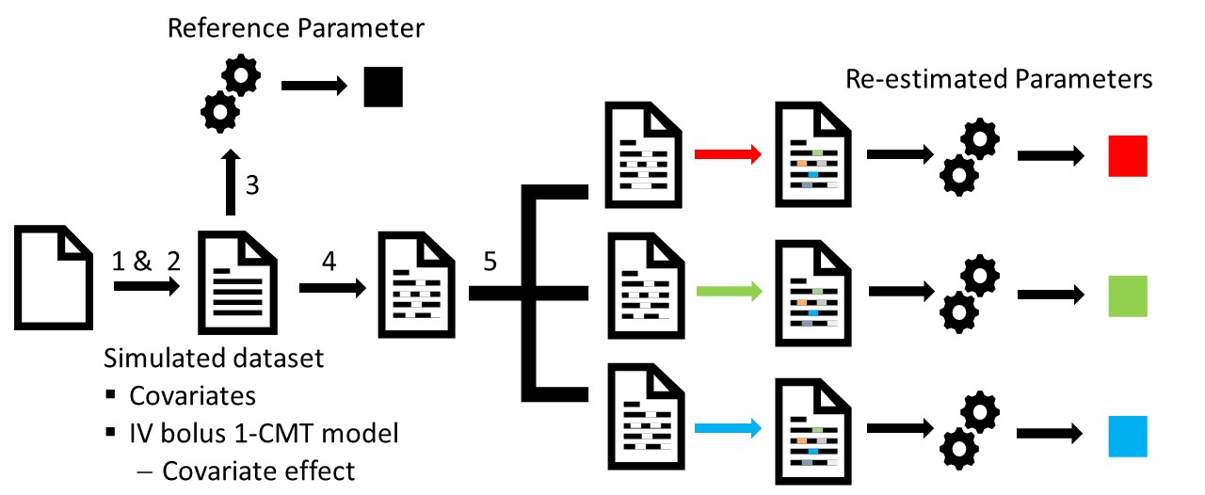
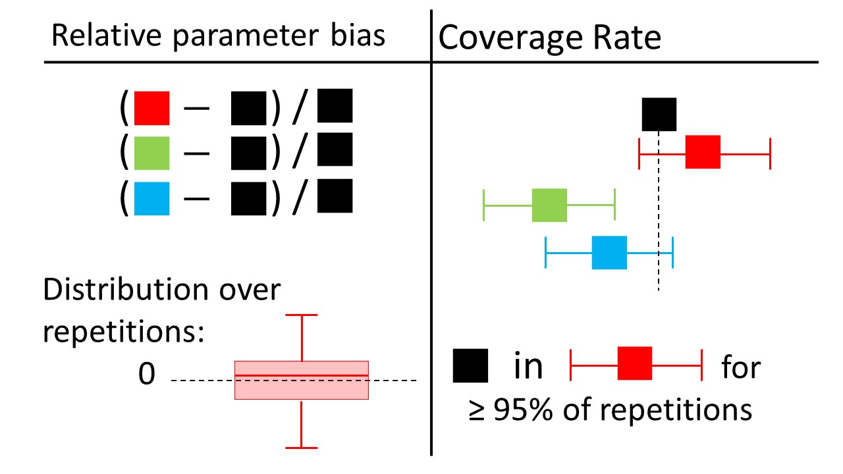
Evaluation of Machine Learning Methods for Covariate Data Imputation in Pharmacometrics
Dominic Bräm^{1*}, Uri Nahum^{1*}, Andrew Atkinson¹, Gilbert Koch^{1†}, and Marc Pfister^{1†}
¹ Universitäts-Kinderspital beider Basel (UKBB), Pediatric Pharmacology and Pharmacometrics, Basel, Schweiz
* Equal contribution; † Shared senior leadership
Contact: dominic.braem@ukbb.ch
Introduction
Let’s stay in contact
Results
Missing data can lead to loss of power or biased results when handled inadequately.
Statistical approaches have been adopted in pharmacometrics such as Listwise Deletion (LD), Mean imputation or multiple imputation methods, e.g. Norm imputation and Predictive Mean Matching (PMM).
Machine learning (ML) methods such as Random Forest (RF) and Artificial Neural Networks (ANN) were proposed for imputation tasks in other fields.
Listwise deletion and Mean imputation can fail under MAR
MAR and linear covariate relationship: LD and Mean imputation show a reduced coverage rate and skewed bias distribution.
Objective: We introduce two ML methods and we evaluate the performance for covariate imputation of statistical and ML approaches
Relative bias distribution for V_{pop} under MAR and linear covariate relationships.
Methods
Model based imputation methods sensitive to covariate relationship
MAR and non-linear covariate relationship: Mean and Norm imputation shows a reduced coverage rate and skewed bias distribution for V_{pop} and β, respectively.
Simulation study to evaluate 6 approaches to handle missing data
Patients (n=215) simulated with covariates based on descriptive statistics of a pediatric clinical data set.
PK concentration-time data simulated with an IV bolus 1-CMT model with linear or non-linear covariate effect.
Reference parameters estimated for complete data set.
Introduction of 20% missing values under Missing At Random (MAR).
Handling missing data with the 6 approaches mentioned above.
Repeat steps 1 to 5 multiple times.
Evaluation of approaches with relative parameter bias and coverage rate (CR).
Relative bias distribution for β under MAR and non-linear covariate relationships.
Schematic presentation of performed simulation study with the 5 steps described below.
Strongly increased omegas with Mean imputation
Standard deviation ω_{V} of random effects is strongly increased with Mean imputation.
Relative bias distribution for ω_{V} under MAR and non-linear covariate relationships.
Conclusions
Machine Learning approaches appropriately impute missing covariate data with high flexibility concerning non-linear relationships and missingness assumption.
Application of some conventionally used imputation methods require strong assumptions to be made about missingness process and covariate relationships.
Schematic description of the two evaluation approaches and their optimal outcome

