Slide 1
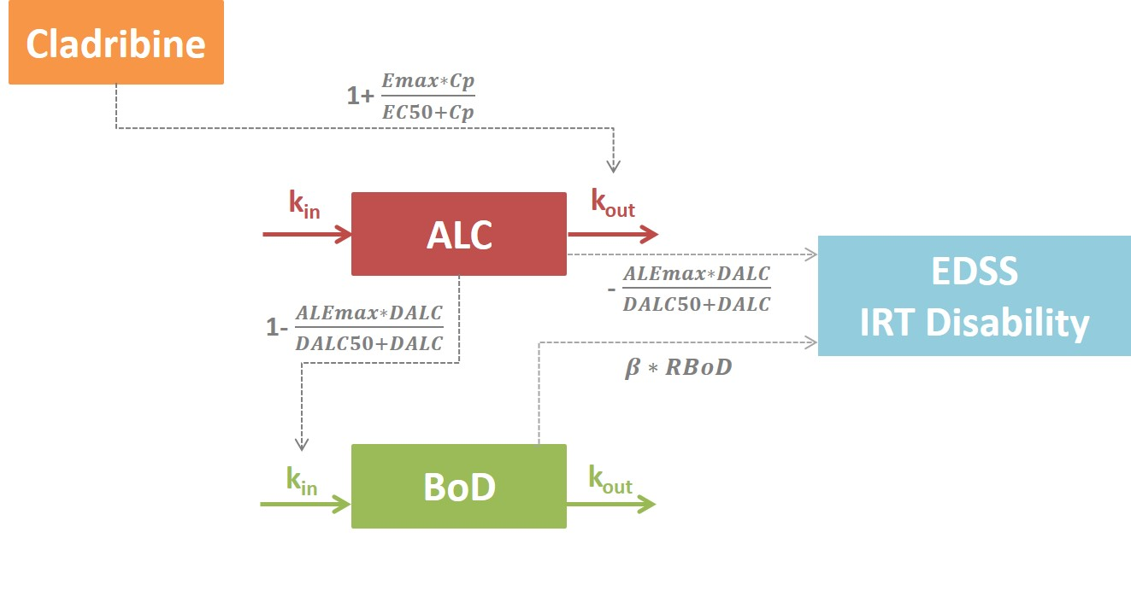
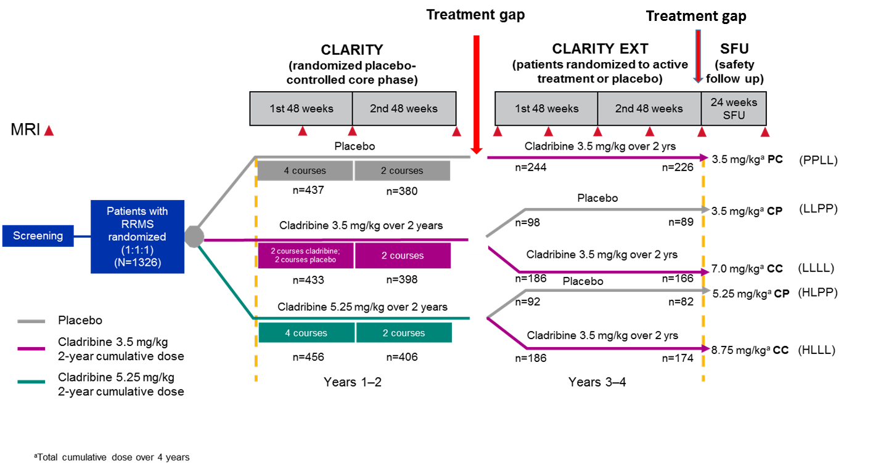
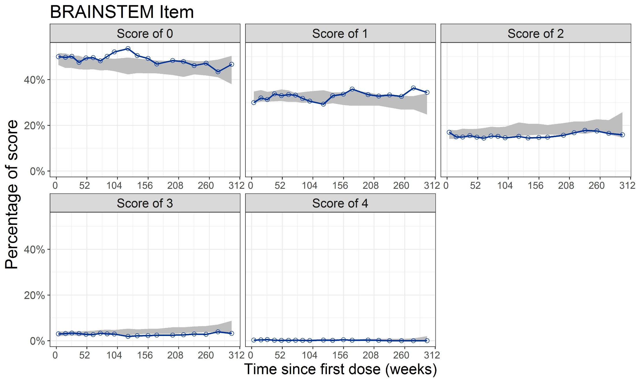
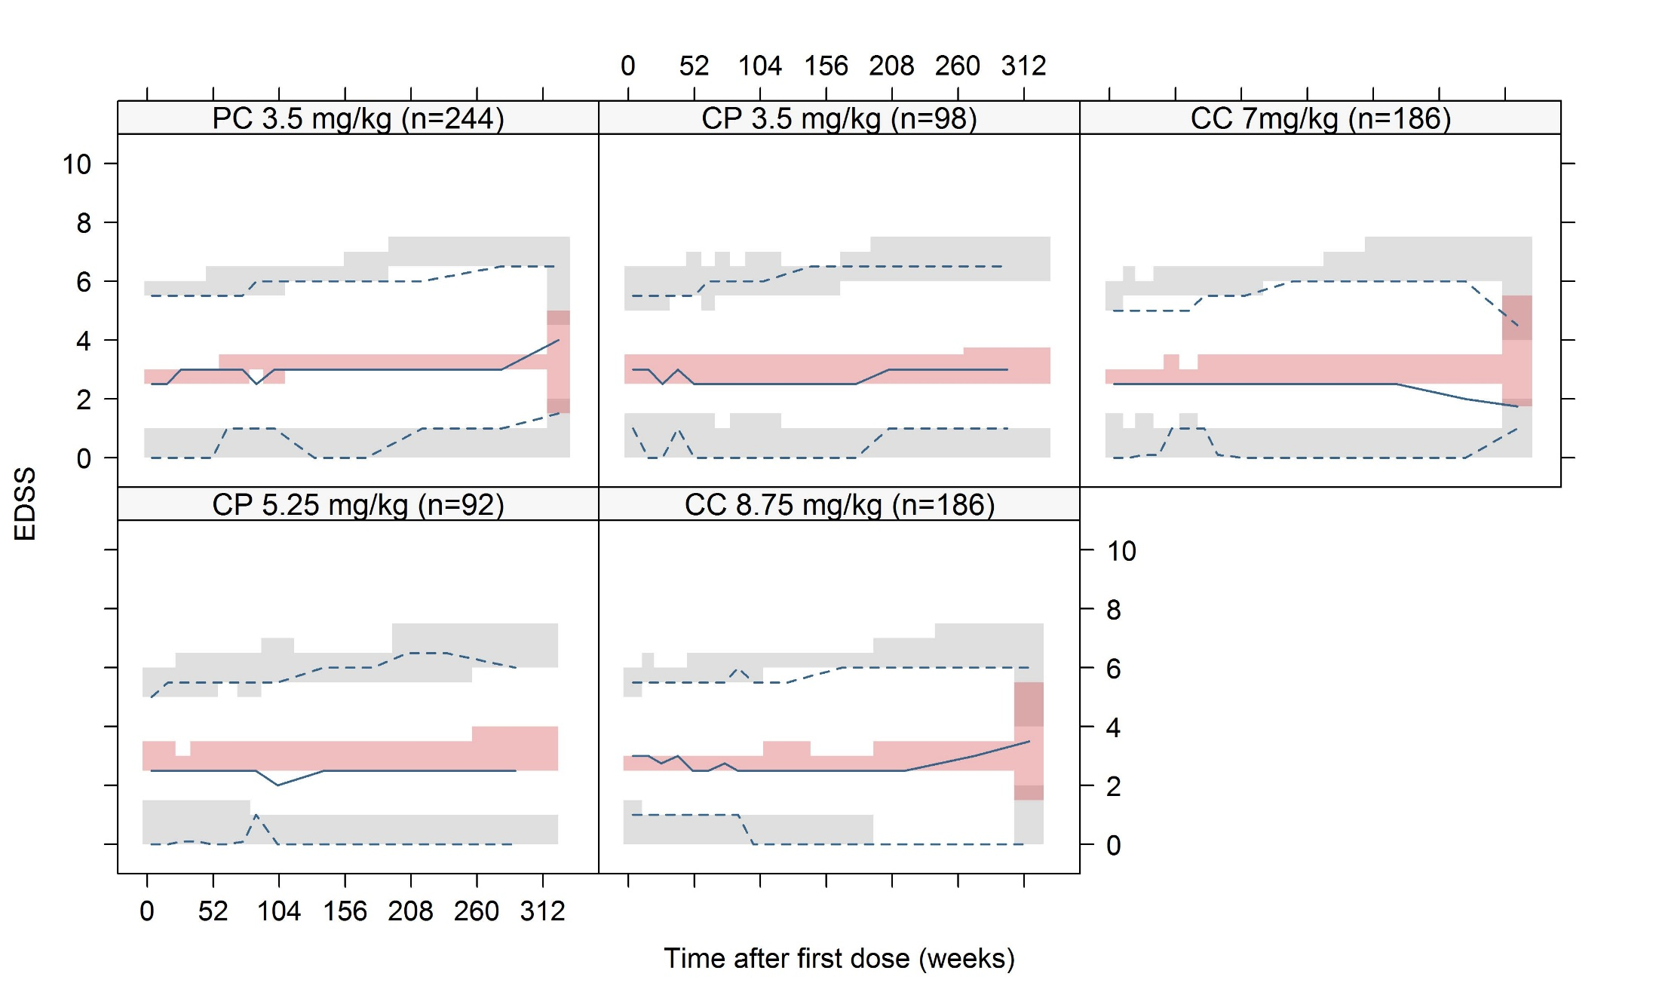
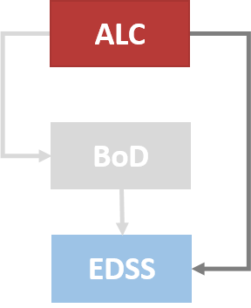
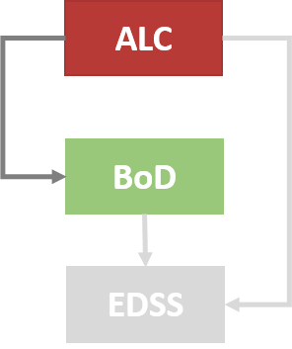
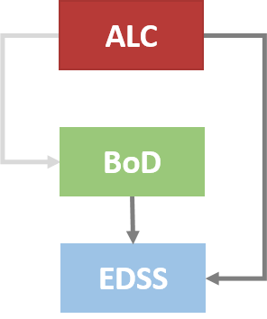
A longitudinal model linking absolute lymphocyte count (ALC) and volume of T2 lesions to expanded disability status scale (EDSS) in patients with relapsing-remitting multiple sclerosis (RRMS)
Ana M. Novakovic^{1,2}, Sebastian Ueckert¹, Alain Munafo³, Mats O. Karlsson¹
¹ Dept of Pharmaceutical Biosciences, Uppsala University, Uppsala, Sweden ² Present affiliation: Pharmacometry, Merck KGaA, Darmstadt, Germany ³ Merck Institute for Pharmacometrics, Lausanne, Switzerland
Objectives
Results
To establish the relationship between three clinical markers for RRMS: ALC, a marker of the pharmacological effect of cladribine tablets; total volume of T2 lesions, an MRI (Magnetic Resonance Imaging) readout representing the burden of disease (BoD) and EDSS, a long-term marker of disease progression, using Item Response Theory (IRT) methodology.
Using the complete time course of ALC, BoD and all 8 items constituting EDSS, the link between ALC-BoD-EDSS items was successfully established (Fig.2, Table 1).
Background
Treatment of patients with MS and development of new therapies have been challenging due to the complexity of the disease, its slow progression, and the limited sensitivity of available clinical assessment outcomes.
The utility and pressing need for biomarkers in MS has been extensively demonstrated, but so far no single endpoint/biomarker has fulfilled all the requirements [1].
IRT approaches have demonstrated numerous advantages in analyzing composite score outcomes [2].
EDSS is a 20 point scale (0=normal neurological exam and 10=death due to MS), based on the neurological assessment of 7 functional systems and of walking ability.
Figure 2. Schematic representation of the modeling framework
Table 1. Parameter estimates and uncertainties for the final model
Methods
Inclusion of total T2 volume as mediator of underlying disability improved the EDSS model fit on top of the relative change from baseline ALC (DALC) (p<0.001).
However, DALC remained the single most predictive variable for EDSS time-course (p<0.001), the higher the reduction in ALC, the lower the increase in EDSS.
Parameter | Typical parameter |  | Between-subject variability
 | Estimate | (%RSE) | ω | (%RSE)
$α_{i}$ (years⁻¹) | 0.146 | (11) | 0.08 | (12)
$$pwr$$ | 0.763 | (4) | -
Correlation Dis_{0,i}/$α_{i}$ | 0.127 | (61) | -
$${DALC}_{emax,i}$$ | 0.0258 | (16) | 2.38 | (11)
$${DALC}_{50}$$ | 0.187 | (45) | -
$$β$$ | 0.034 | (12) | 0.46 | (22)
Patients and Data
Data were collected from two Phase III clinical studies: CLARITY and CLARITY EXT investigating the efficacy of cladribine tablets in 1319 patients [3,4].
Blood samples used for ALC measurements were collected at study day 1 (SD1) and at weeks 5, 9, 13, 24, 44, 48, 52, 72 and 96 during the CLARITY trial and at SD1 and at weeks 2, 5, 9,13,16, 24, 36, 44, 48, 52, 55, 60, 66, 72, 78, 84 and 96 during the CLARITY EXT
BoD and EDSS assessment were conducted at SD1 and then every 24 and 12 weeks, respectively, during the duration of the study.
The final IRT model allowed adequate description of EDSS data on both the item (as shown for brainstem item in Fig.3) and total score level (Fig.4).
Figure 3. Visual predictive checks (VPC) describing the time-courses of each score for the brainstem item. Median (blue solid line) of the observed data is compared to the 95% prediction interval (gray shaded area) for the simulated data
Figure 1. Overview of trial design of CLARITY and CLARITY EXT. Abbreviations: C: cladribine, P: placebo
Previously developed model
ALC model: Indirect response model with stimulation of lymphocyte elimination by cladribine through Emax drug-effect relationship (Eq.1)
$$\frac{dALC}{dt}=k_{in}−k_{out}∙\left(1+\frac{E_{max}∙C_{p}}{C_{50}+C_{p}}\right)∙ALC\left(t\right)$$
Figure 4. VPC for the ALC&BoD-EDSS model stratified by treatment arm. The observed median (solid blue line) and 2.5th and 97.5th percentiles (lower and upper dashed blue lines, respectively) is compared with the 95 % confidence interval for the median (orange shaded area) and the 2.5th and 97.5th percentiles (lower and upper light-grey shaded area, respectively) of the simulated data.
(Eq.1)
Modeling workflow
Due to expected long run times, the sequential modeling approach IPP (Individual PK Parameters) was applied in the analysis of ALC and the respective efficacy endpoints BoD and EDSS [5].
The effect of ALC was explored by including model predicted ALC related measure called DALC: the relative change of the individual the model predicted ALC at time t (ALC_{i,t}) from the individual model predicted baseline ALC (ALC_{0,i}), as independent variable in the EDSS and BoD models (Eq.2).
$${DALC}_{i,t}=1−\frac{{ALC}_{i,t}}{{ALC}_{0,i}}$$
(Eq.2)
ALC-EDSS model:
Assessment of model-predicted ALC as a predictor of EDSS dynamics
The nonlinear disease progression model of the latent variable (D) with Emax DALC-effect relationship (Eq.3).
Conclusions
$$\frac{dD}{dt}=α_{i}∙pwr∙t^{pwr−1}−\frac{{DALC}_{emax,i}∙{DALC}_{i,t}}{{DALC}_{50}+{DALC}_{i,t}}$$
ALC-related measures are the strongest predictors of the effect of cladribine on EDSS
Our findings confirm the well-documented lack of proof of surrogacy of total T2 volume for EDSS [7].
However, they indicate that lesions progression (as assessed by MRI) is nevertheless associated with disease progression (as measured by EDSS).
The proposed model is the first dose-exposure-biomarkers-clinical endpoint model integrating the IRT methodology. It offers a platform for the quantitative understanding of the biomarker(s)/clinical endpoint relationship in RRMS.
(Eq.3)
ALC-BoD model:
Assessment of model-predicted ALC as a predictor of BoD dynamics
Indirect response model with inhibition of lesion formation by cladribine through Emax DALC-effect relationship (Eq.4), using model developed by Savic et al. [6] as starting point
$$\frac{dBoD}{dt}=k_{in}∙\left(1−\frac{{DALC}_{emax,i}∙{DALC}_{i,t}}{{DALC}_{50}+{DALC}_{i,t}}\right)−k_{out}∙BoD$$
(Eq.4)
BoD-EDSS vs. (BoD+ALC)-EDSS model:
Assessment of model predicted BoD as predictors of EDSS dynamics alone or as a joint predictor with ALC
The individual model- predicted relative or, absolute BoD changes from baseline and rate of BoD change (RBoD) were investigated as predictors of EDSS (Eq.5)
References
[1] Martin, Dis Markers 22:183-5, 2006
[2] Ueckert, Pharm Res 31:2152, 2014
[3] Giovannoni, N Engl J Med 362(5):416-26, 2010
[4] Giovannoni, Neurology 86(16) Supp P3,028, 2016
[5] Zhang, JPKPD 30:405-16, 2003
[6] Savic, PAGE 2011
[7] Sormani, Neurology 75(4):302-9, 2010
$$\frac{dD}{dt}=(α_{i}+\left|α_{i}\right|∙β∙BoD)∙pwr∙t^{pwr−1}−\frac{{DALC}_{emax,i}∙{DALC}_{i,t}}{{DALC}_{50}+{DALC}_{i,t}}$$
(Eq.5)
Contact: mats.karlsson@farmbio.uu.se

