Slide 1
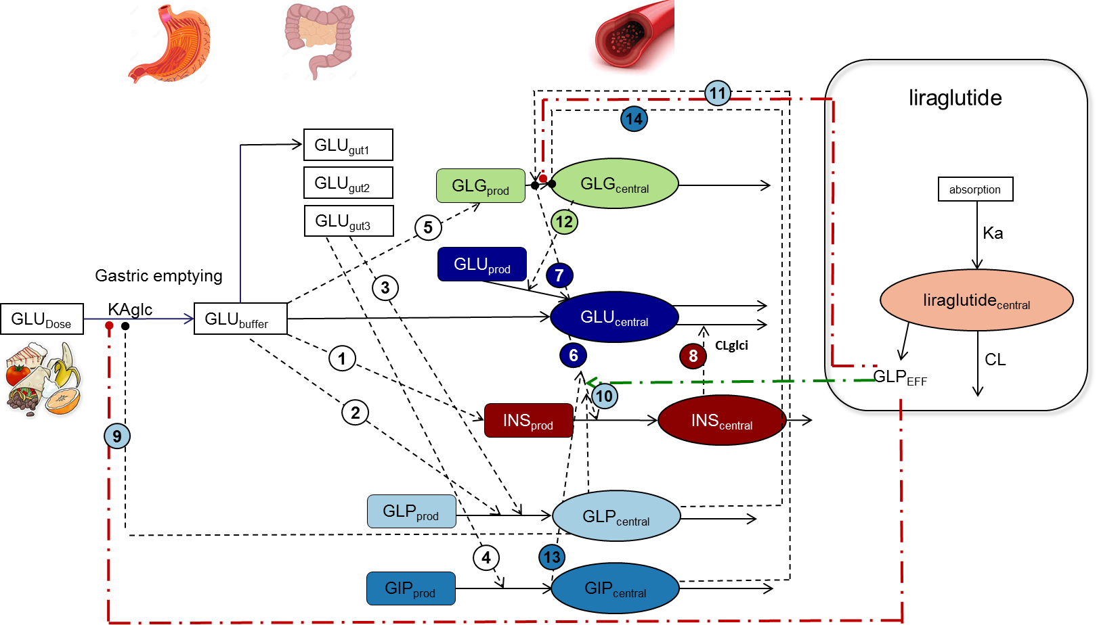
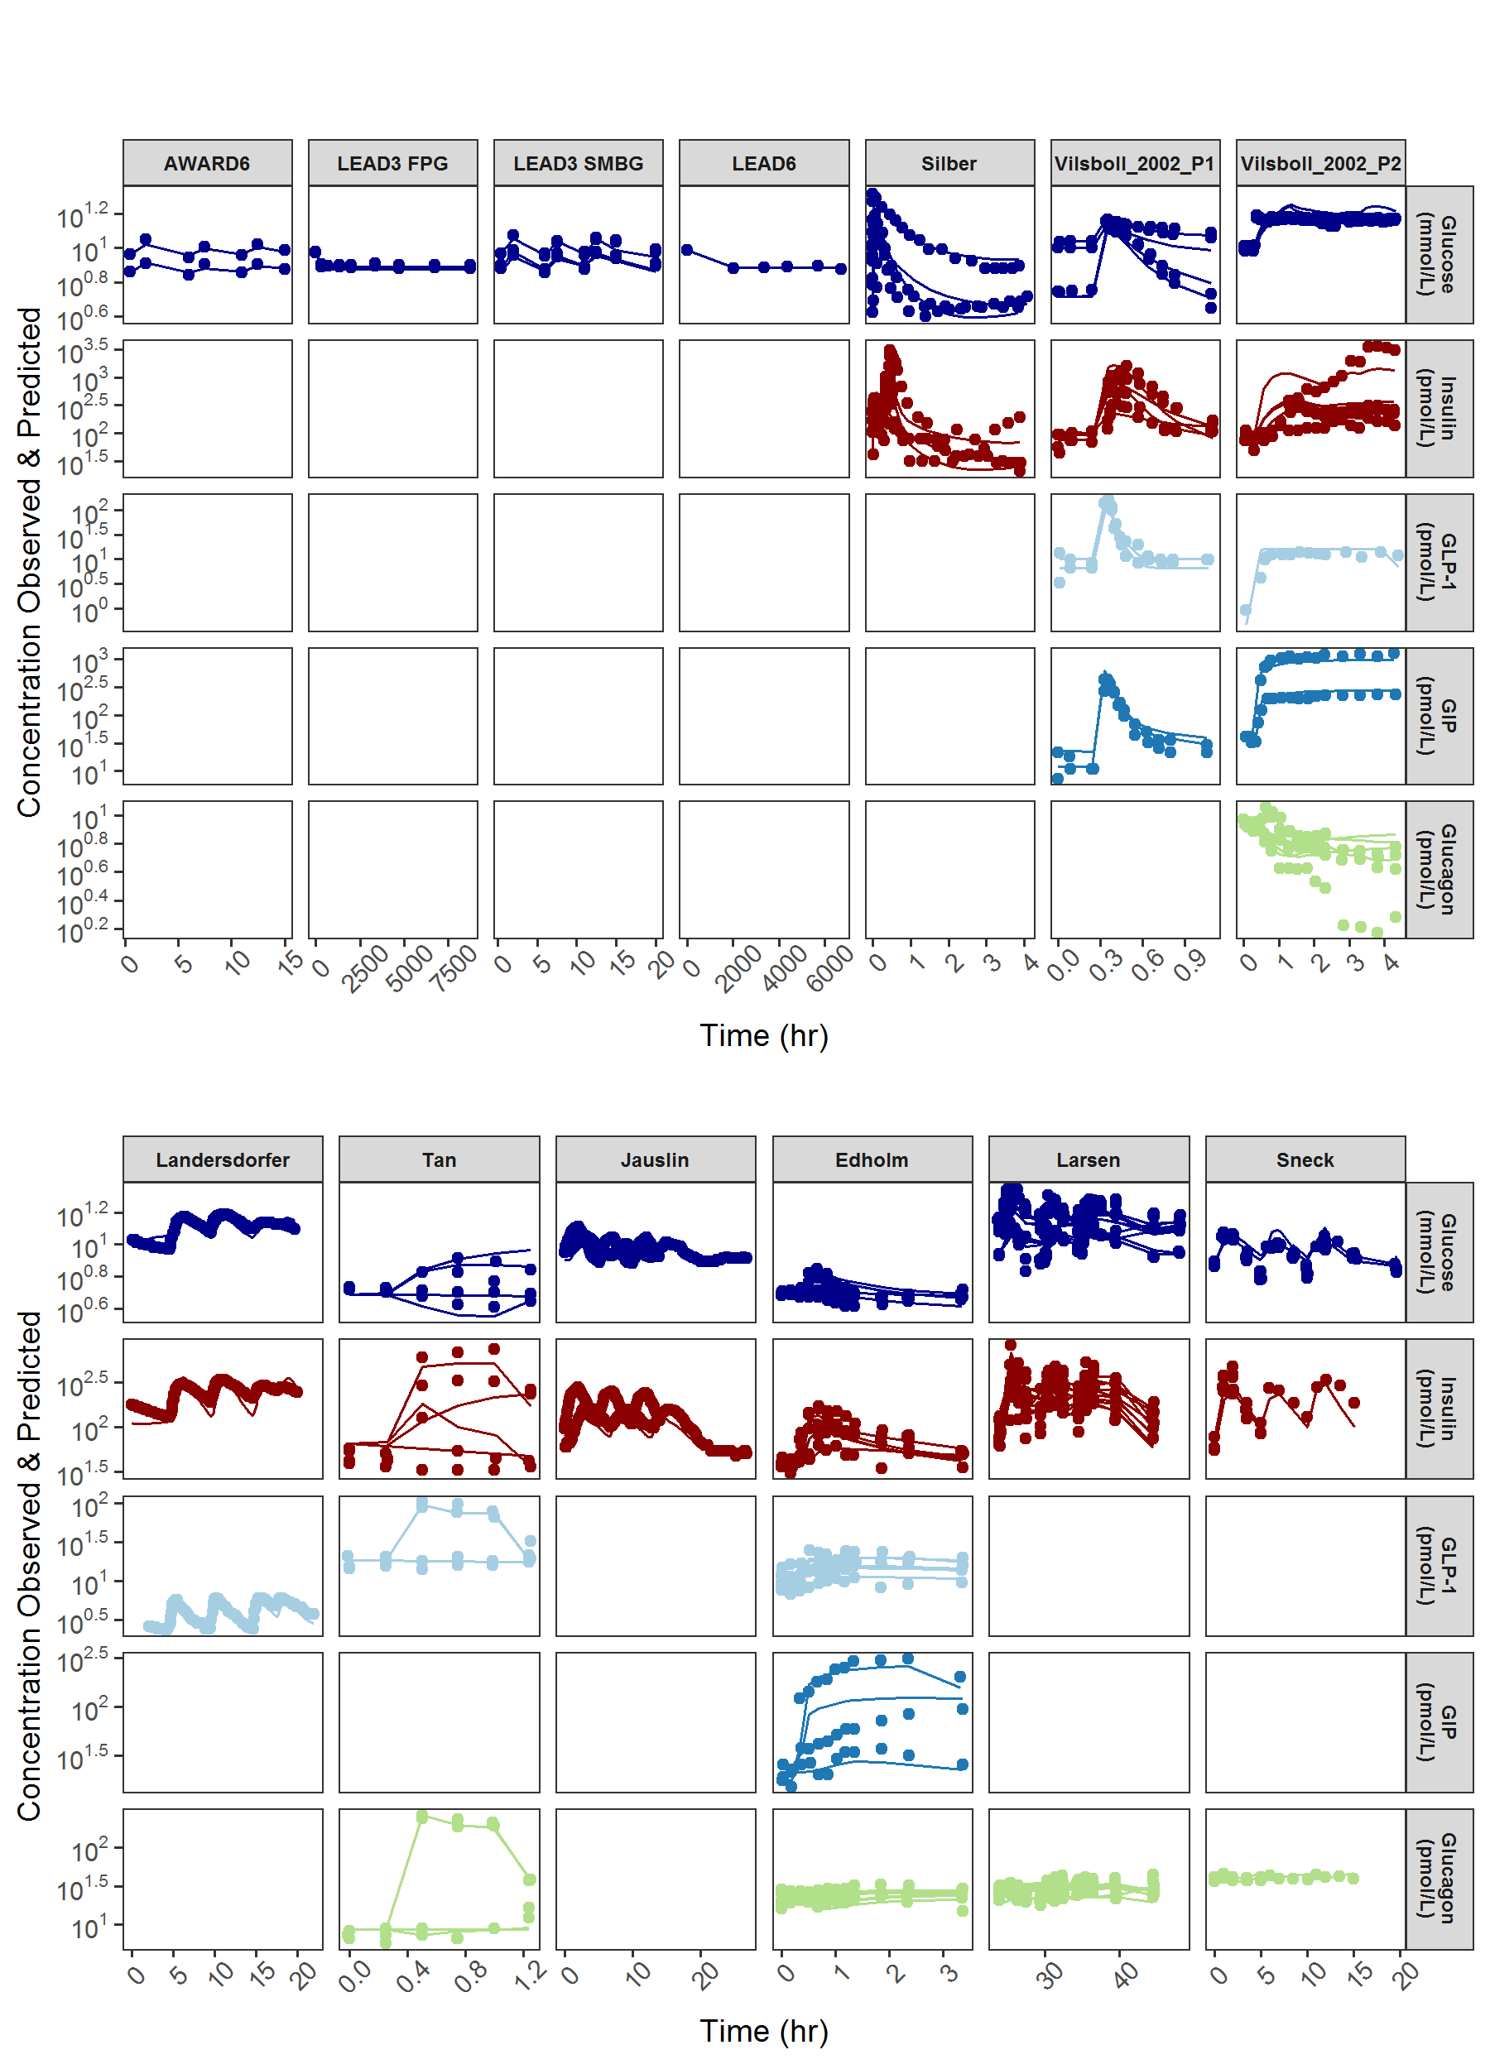
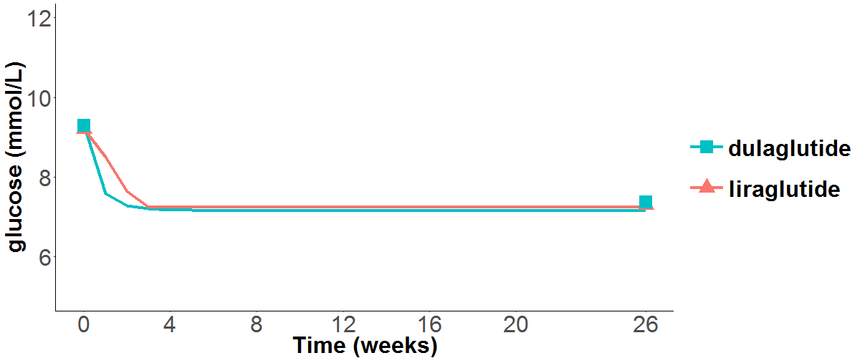
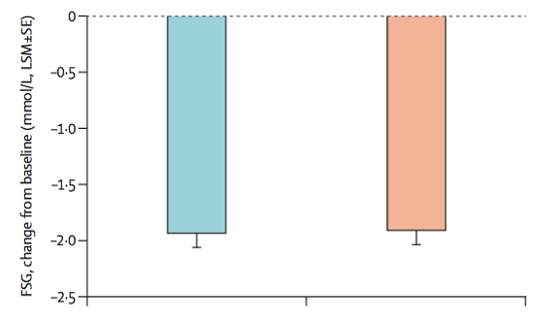
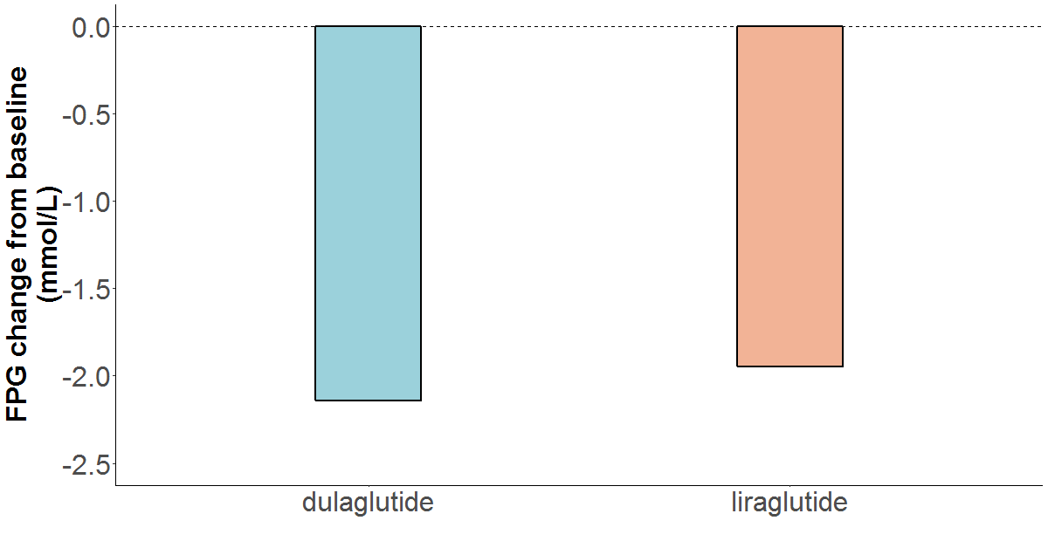
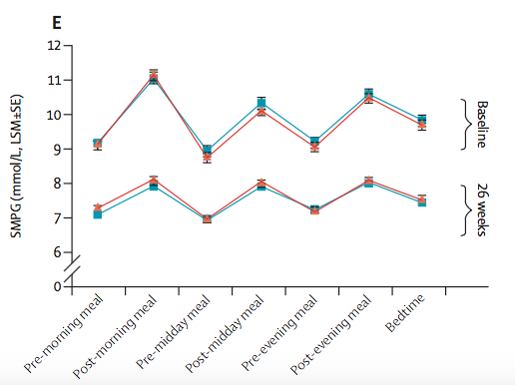
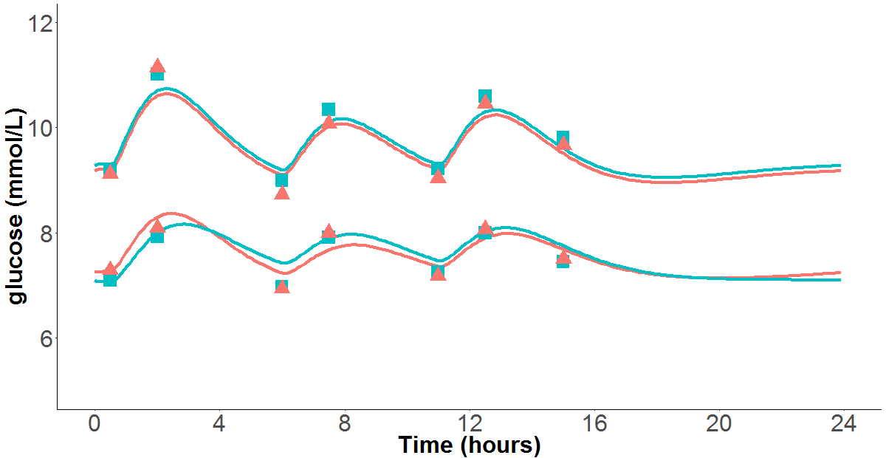
Rolien Bosch¹, Marcella Petrone², Paolo Vicini², Nelleke Snelder¹ ¹LAP&P Consultants Leiden, The Netherlands, ²MedImmune, Cambridge, United Kingdom Contact: info@lapp.nl
A novel integrated QSP model of in vivo human glucose regulation to support development of a glucagon/GLP-1 dual agonist.
Introduction
Objectives
Methods
MEDI0382 is a synthetic linear peptide with dual glucagon-like peptide-1 (GLP-1) and glucagon receptor agonist activity.
The combination of GLP-1 and glucagon activity has been shown to
Improve glycaemic control and lipid profiles, and
Cause significant weight loss in preclinical studies [1].
These effects are hypothesized to be mediated through:
Stimulation of glucose-mediated insulin release (the incretin effect),
Delayed gastric emptying
Increased fatty acid oxidation.
Mechanistic PKPD models are available to quantify drug effects on glucose, insulin and GLP-1 dynamics in humans [2-4]. However, the integrated interrelationship between glucagon and the GLP-1 and glucagon effects on gastric emptying has not been captured in these models.
The aim of this research is to develop a quantitative systems pharmacology (QSP) model that characterises the interrelationship between glucose, GLP-1, glucagon and glucose-dependent insulinotropic peptide (GIP) and insulin (4GI) , which can be used to support development of drugs modulating glucose regulation pathways.
Literature data was digitized and converted in a NONMEM dataset [2-13].
The integrated glucose-insulin (IGI) model by Silber et al [2,3], in combination with knowledge from the Landersdorfer model [4], was used as a starting point, and glucose and insulin disposition parameters were fixed to the published values.
The model was adjusted and extended to describe glucagon, GLP-1 and GIP dynamics.
Liraglutide pharmacokinetics [14] was included to model the effects of liraglutide on glucose concentrations.
In vitro potencies were used to scale between compounds.
The model was externally validated by predicting the effects of another GLP-1 agonist, dulaglutide, on glucose. For this, the 4GI model was combined with a published dulaglutide PK model [15], and used to predict the effects of dulaglutide on fasting and postprandial plasma glucose levels from the AWARD-6 study [13].
Data
A selection of published clinical data was used that included various, non-pharmacological challenges to glucose regulated pathways (e.g. intravenous glucose, meals, glucagon and incretins). Mean data from three clinical studies (LEAD-3, LEAD-6 and AWARD-6), in which the effect of liraglutide (a GLP-1 agonist) on glucose and insulin was investigated, were also added to the dataset. An overview of the data is shown in Figure 2 under the Results section.
Model
The 4GI model consist of 5 central compartments that describe glucose, insulin, active GLP-1, GIP and glucagon dynamics and are interconnected trough feedback mechanisms.
A schematic overview of the 4GI model is shown in Figure 1.
The feedback mechanisms that could be identified with good precision are shown in Table 1.
The Liraglutide PK model from Watson et al. [14] was added to the 4GI model to model the effects of liraglutide on glucose.
During model development several assumptions were made (Details upon request).
Known differences between HV and T2DM were taking into account.
Effect and nr. in Fig. 2 |  | Description | Type
Food effects | 1 | Food stimulates insulin | linear
 | 2 | food (buffer) on GLP1 (gut) | linear
 | 3 | food (gut) on GLP1 (gut) | power
 | 4 | Glucose from gut on GIP | linear
 | 5 | Food stimulates glucagon | linear
Glucose effects | 6 | Glucose on insulin secretion | linear
 | 7 | Glucose on glucagon secretion | power
Insulin effects | 8 | Insulin on glucose clearance
GLP-1 effects | 9 | GLP1 on Glucose absorption | EMAX
 | 10 | GLP1 on glucose dependent insulin secretion | EMAX
 | 11 | GLP1 on glucagon secretion | EMAX
Glucagon effects | 12 | Glucagon on glucose secretion | EMAX
GIP effects | 13 | GIP on insulin secretion | power
 | 14 | GIP increases glucagon | power
Figure 1 Schematic overview of the 4GI model
Table 2 Overview of feedback mechanisms
Results
Published clinical data
Simulated clinical data
Glucose, insulin, GLP-1, GIP and glucagon dynamics were described adequately by the developed QSP model [Figure 2].
To externally validate model predictions, the effects of dulaglutide, a once weekly administered GLP-1 agonist was simulated.
The 4GI model code was converted to R code and the dulaglutide PK model [15] was added to the model.
Liraglutide and dulaglutide were both tested in the AWARD-6 clinical study [Figure 3].
Re-simulating the AWARD-6 study showed that the model is able to describe the effects of dulaglutide on both postprandial as well as fasting glucose [Figure 4].
A
A
B
B
C
Basline
26 weeks
Figure 2 Observed and predicted levels of glucose (dark blue), insulin (dark red), GLP-1 (sky blue), GIP (light blue), and glucagon (green).
Figure 3 Published clinical data on AWARD-6 study [13] A: Drop in fasting glucose after 26 wks. B: Self measured plasma glucose levels at baseline and after 26 wks.
Figure 4 Observed (points) and simulated effects (solid lines) of liraglutide and dulaglutide on fasting (A + B) and post-prandial (C) glucose levels.
Conclusion
A novel integrated QSP model characterizing important known feedback mechanisms between glucose, insulin, glucagon, GLP and GIP (4GI) after food intake and/or drug administration was developed and externally validated using literature data. The 4GI model can be proposed as a quantitative decision making tool to support progression of novel molecules modulating these pathways. Future 4GI model features may include e.g. integrating mechanisms of energy expenditure and the effect of weight and lipid changes.
[1] S. J. Henderson PhD, A. Konkar PhD, D. C. Hornigold PhD, J. L. Trevaskis PhD, R. Jackson PhD, M. Fritsch Fredin PhD, R. Jansson-Löfmark PhD, J. Naylor PhD, A. Rossi PhD, M. A. Bednarek PhD, N. Bhagroo, H. Salari, S. Will | S. Oldham, G. Hansen MSc, M. Feigh PhD, T. Klein PhD, J. Grimsby PhD, S. Maguire, L. Jermutus PhD, C. M. Rondinone PhD, M. P. Coghlan PhD, Diabetes, Obesity and Metabolism December 2016; 18: 1176–1190.
[2] Silber HE, Jauslin PM, Frey N, Gieschke R, Simonsson USH, Karlsson MO. J Clin Pharmacol 2007;47:1159–71.
[3] Petra M. Jauslin, PhD, Nicolas Frey, PharmD, and Mats O. Karlsson, PhD., J Clin Pharmacol 2011;51:153-164
[4] Cornelia B. Landersdorfer, Yan-Ling He & William J. Jusko. ,Br J Clin Pharmacol, 73:3, 373–390
[5] Tricia M. Tan, 1 Benjamin C.T. Field, 1 Katherine A. McCullough, 1 Rachel C. Troke, Edward S. Chambers, Victoria Salem, Juan Gonzalez Maffe, Kevin C.R. Baynes, Akila De Silva, Alexander Viardot, Ali Alsafi, Gary S. Frost, Mohammad A. Ghatei, and Stephen R. Bloom., , Diabetes. 2013 Apr;62(4)
[6] T. Edholm, M. Degerblad, P. Gryback, L. Hilsted, J. J. Holst, H. Jacobsson, S. Efendic, P. T. Schmidt & P. M. Hellstro M. Neurogastroenterol Motil (2010) 22, 1191–e315
[7] T. Vilsbøll, T. Krarup, S. Madsbad, J. J. Holst. , Diabetologia (2002) 45:1111–1119.
[8] Tina Vilsbøll, Henrik Agersø, Torsten Lauritsen, Carolyn F. Deacon, Kasper Aaboe, Sten Madsbad, Thure Krarup, Jens Juul Holst, Regulatory Peptides 137 (2006) 168–172
[9] Jens Larsen, MD, Birgitte H Ylleberg, Msc, Kevin N G, MD, Peter D Amsbo, MD. , Diabetes Care, Volume 24, Number 8, August 2001.
[10] Karen B. Schneck, Xin Zhang, Robert Bauer, Mats O. Karlsson, Vikram P. Sinha, J Pharmacokinet Pharmacodyn (2013) 40:67–80
[11] A. Garber, R. Henry, R. Ratner, P. A Garcia-Hernandez, H. Rodriguez-Pattzi, I. Olvera-Alvarez, P. M Hale, M. Zdravkovic, B. Bode., The Lancet Vol 373 February 7, 2009
[12] John B. Buse, Giorgio Sesti, Wolfgang E. Schmidt, Eduard Montanya, Cheng-Tao Chang, Yizhen Xu, Lawrence Blonde, Julio Rosenstock. Diabetes Care, Volume 33, Number 6, June 2010.
[13] Kathleen M Dungan, Santiago Tofé Povedano, Thomas Forst, José G González González, Charles Atisso, Whitney Sealls, Jessie L Fahrbach. The Lancet Vol 384 October 11, 2014.
[14] Estelle Watson, MPhil, Daniël M. Jonker, PhD, Lisbeth V. Jacobsen, MSc, and Steen H. Ingwersen, MSc. J Clin Pharmacol 2010;50:886-894
[15] Jeanne S. Geiser, Michael A., Xuewei Cui, Jennifer Martin, Corina Loghin, Jenny Y. Chien, Amparo de la Pen, 2016 May;55(5):625-34

